Slide 1
Welcome to Microsoft Defender for Cloud Day 2

Slide 2
A look into Day 2
Kick-Off | 8:00-8:05 | Welcome | Main Call
 | 8:05-9:15 | Microsoft Defender for Cloud Part III
 | 9:15-9:30 | Break
Ingest | 9:30-10:15 | Microsoft Defender for Cloud - Part IV
 | 10:15-10:30 | Activity 3: Microsoft Defender for Cloud
 | 10:30-11:30 | Build Hands-on: Microsoft Defender for Cloud
 | 11:30-12:30 | Long Break | Table Group Call
Transform | 12:30-1:45 | Attack Patterns + Analysis + Emerging Threats | Main Call
 | 1:45-2:00 | Break
 | 2:00-2:35 | Activity 4: Attack Patterns
 | 2:30-3:00 | Preparing for the Worse / BCDR
 | 3:00-3:30 | Activity 5: Restoring Systems
 | 3:30-4:00 | Build Hands-on: Clearing Recommendations | Table Group Call
 | 4:00-4:15 | Closing | Main Call
Today we will be learning and collaborating across three spaces:
Main call (this meeting)
Table Group channel within the event Team
CloudLabs Learner Portal & Lab environment
Presentation/
Whole Group
Lab
Activity/ Discussion/ Group Work
Announcements

Slide 3
Container Registry Image Scanning

Slide 4



Container Protection
Kubernetes clusters - Continuous assessment of your clusters to provide visibility into misconfigurations and guidelines to help you mitigate identified threats.
Container hosts - Continuous assessment of your Docker environments to provide visibility into misconfigurations and guidelines to help you mitigate threats
Azure Container Registry (ACR) - Vulnerability assessment and management tools for the images in your Azure Resource Manager-based ACR registries

Slide 5
Microsoft Defender for Cloud for Container Registries
Microsoft Defender for Cloud for Container Registries includes a vulnerability scanner to scan the images in your Azure Resource Manager-based Azure Container Registry registries and provide deeper visibility into your images' vulnerabilities.
Microsoft Defender for Cloud will scan all images when they’re pushed to the registry, imported into the registry, or pulled within the last 30 days. The integrated scanner is powered by Qualys, the industry-leading vulnerability scanning vendor.
You’ll be charged for every image that gets scanned – once per image.

Slide 6
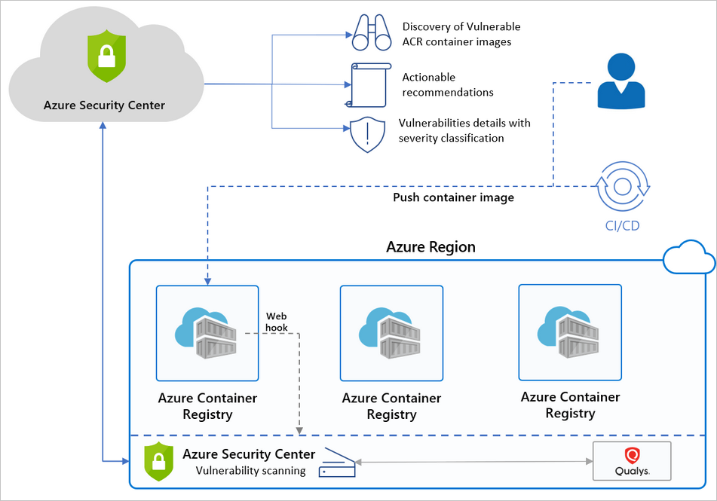
Azure Container Registry
Azure Container Registry (ACR) is a managed, private Docker registry service that stores and manages your container images for Azure deployments in a central registry.
It's based on the open-source Docker Registry 2.0.

Slide 7
Container Registry - Image Scanning
There are three triggers for an image scan:
On push - Whenever an image is pushed to your registry, Microsoft Defender for Cloud automatically scans that image. To trigger the scan of an image, push it to your repository.
Recently pulled - Since new vulnerabilities are discovered every day, Microsoft Defender for Cloud for container registries also scans, on a weekly basis, any image that has been pulled within the last 30 days. There's no additional charge for these rescans; as mentioned above, you're billed once per image.
On import - Azure Container Registry has import tools to bring images to your registry from Docker Hub, Microsoft Container Registry, or another Azure container registry. Microsoft Defender for Cloud for container registries scans any supported images you import.
The scan completes typically within 2 minutes, but it might take up to 15 minutes.
Notes:
https://docs.microsoft.com/en-us/azure/security-center/defender-for-container-registries-usage

Slide 8
Container Registry - How does it work?
Microsoft Defender for Cloud pulls the image from the registry and runs it in an isolated sandbox with the Qualys scanner. The scanner extracts a list of known vulnerabilities.
Microsoft Defender for Cloud filters and classifies findings from the scanner.
When an image is healthy, Microsoft Defender for Cloud marks it as such.
Microsoft Defender for Cloud generates security recommendations only for images that have issues to be resolved. By only notifying you when there are problems, Microsoft Defender for Cloud reduces the potential for unwanted informational alerts.

Slide 9
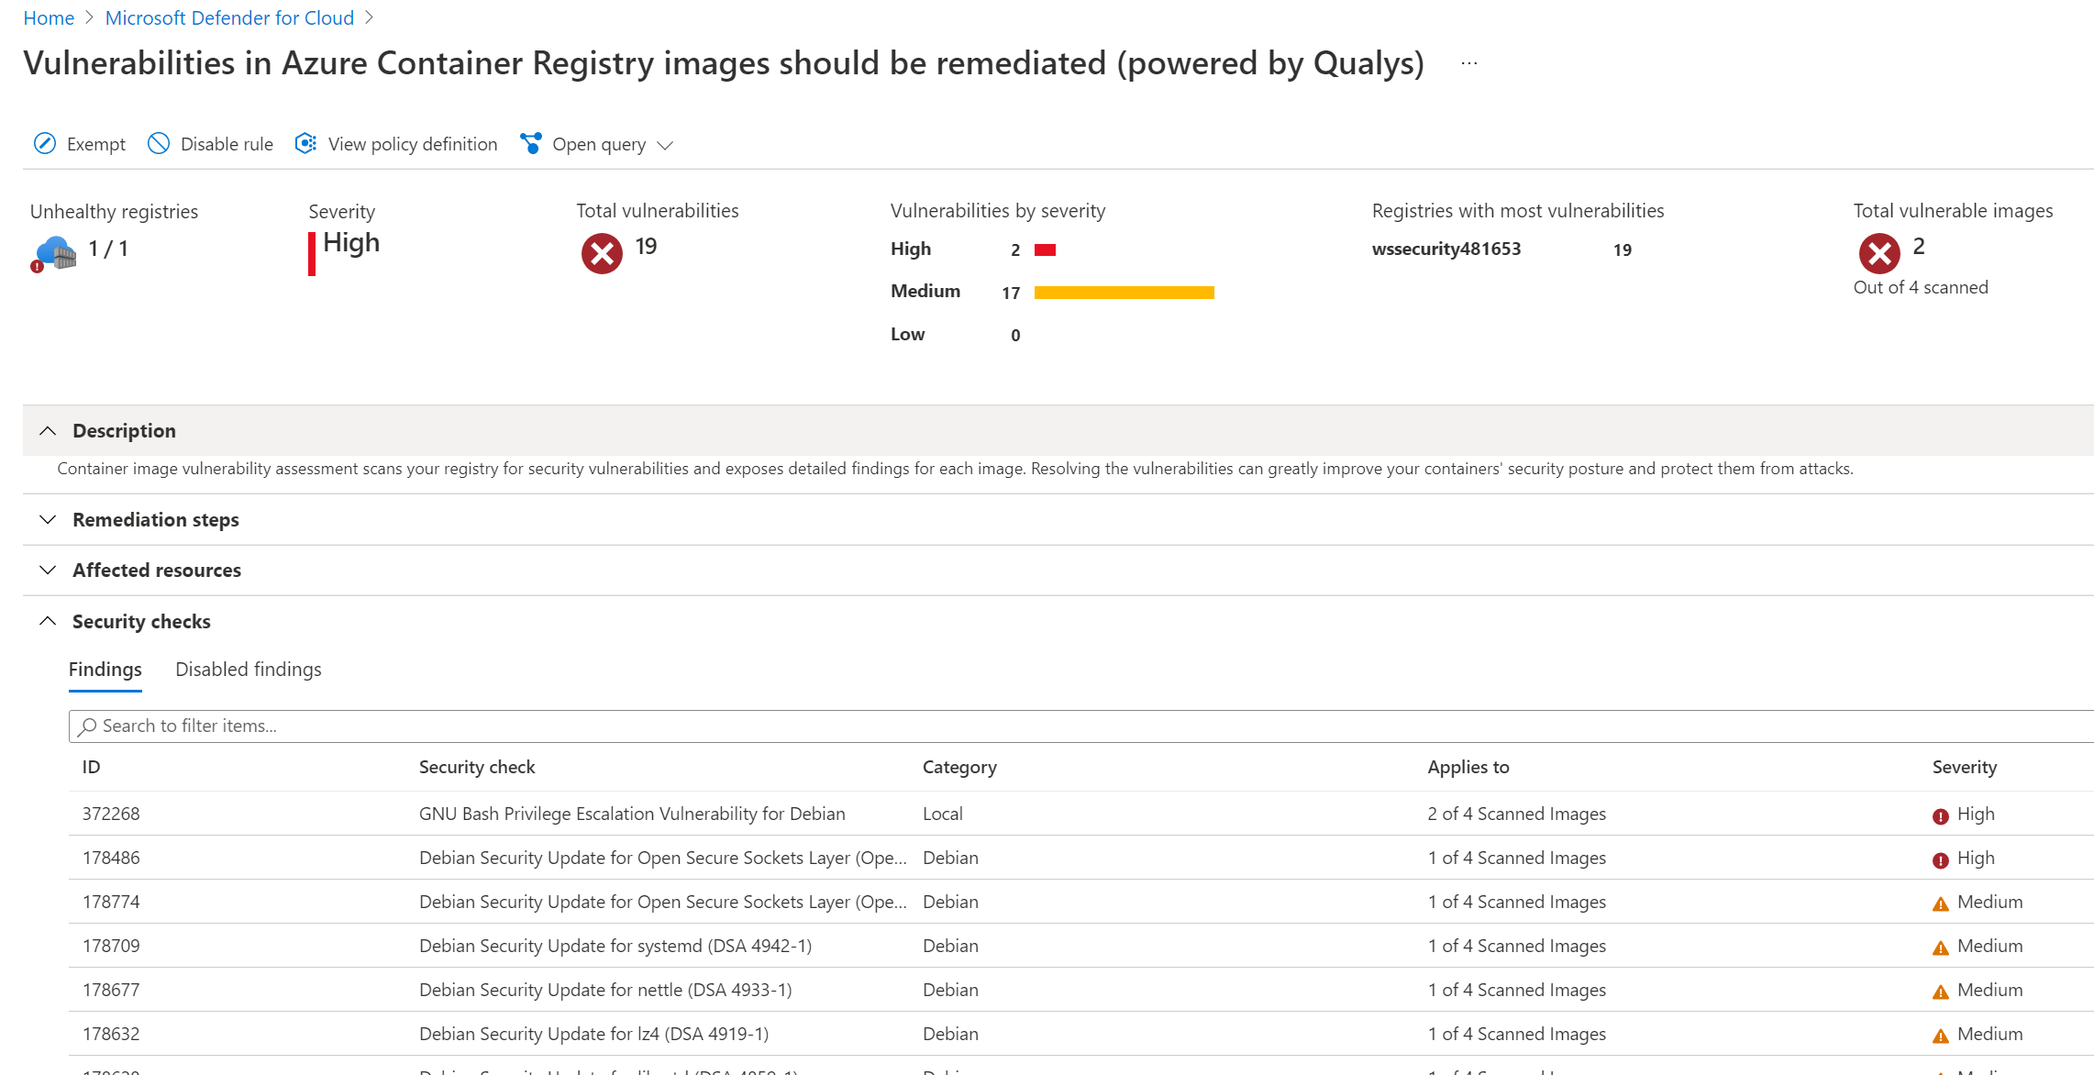
Image Scanning Results

Slide 10
Microsoft Defender for Cloud for Kubernetes

Slide 11
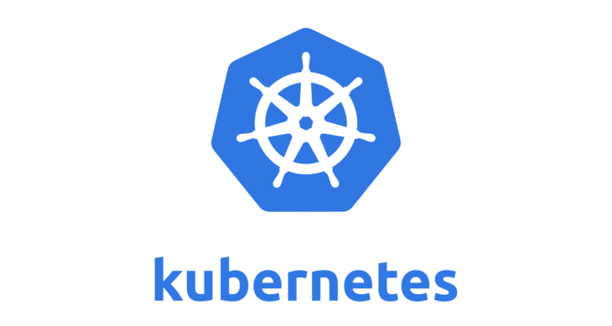
Azure Kubernetes Service
Microsoft Defender for Cloud defends your Kubernetes clusters whether they're hosted in Azure Kubernetes Service (AKS), on-premises, or on other cloud providers. clusters.
Microsoft Defender for Cloud and AKS form a cloud-native Kubernetes security offering with environment hardening, workload protection, and run-time protection
Provides cluster-level threat protection by monitoring your clusters' logs.
Notes:
https://docs.microsoft.com/en-us/azure/security-center/alerts-reference#alerts-k8scluster
https://docs.microsoft.com/en-us/azure/security-center/alerts-reference#alerts-containerhost

Slide 12
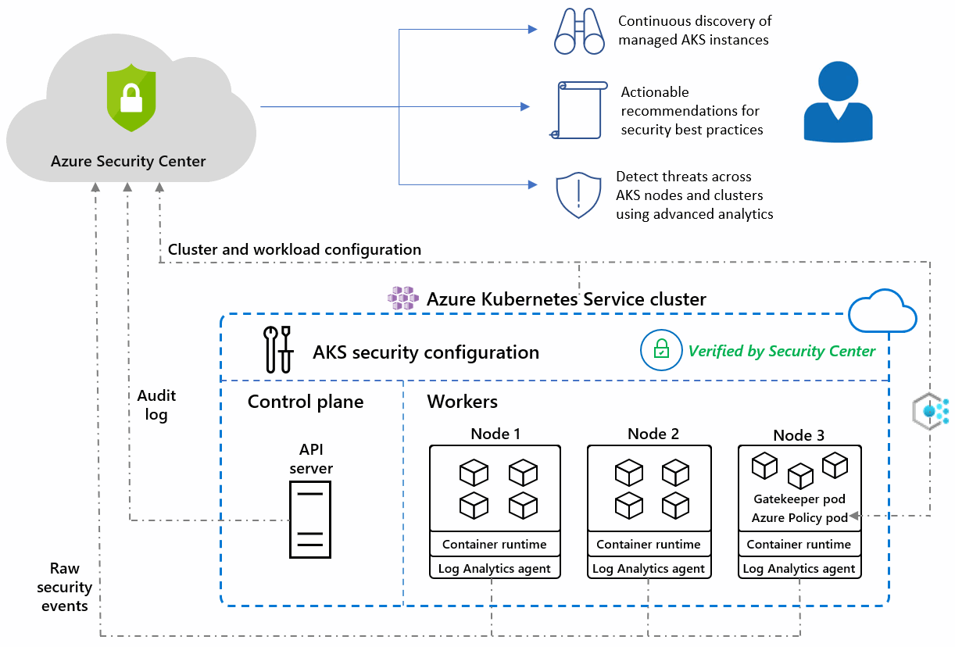
Azure Kubernetes Service
Notes:
https://docs.microsoft.com/en-us/azure/security-center/defender-for-kubernetes-introduction

Slide 13
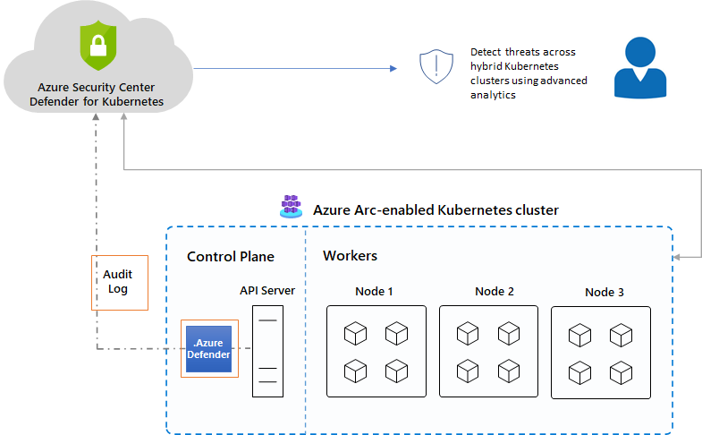
Azure Arc enabled AKS
The Microsoft Defender for Cloud for Kubernetes clusters extension can defend your on-premises clusters with the same threat detection capabilities offered for Azure Kubernetes Service clusters.
Notes:
https://docs.microsoft.com/en-us/azure/security-center/defender-for-kubernetes-azure-arc?tabs=k8s-deploy-asc%2Ck8s-verify-asc%2Ck8s-remove-arc

Slide 14

Container Scanning (Docker)
Microsoft Defender for Cloud identifies unmanaged containers hosted on IaaS Linux VMs, or other Linux machines running Docker containers.
When you're exploring the security issues of a VM, Microsoft Defender for Cloud provides additional information about the containers on the machine.
Such information includes the Docker version and the number of images running on the host.
Microsoft Defender for Cloud includes the entire ruleset of the CIS Docker Benchmark and alerts you if your containers don't satisfy any of the controls. When it finds misconfigurations, Security Center generates security recommendations.
The CIS benchmark checks don't run on AKS-managed instances or Databricks-managed VMs.

Slide 15
Microsoft Defender for Cloud for App Service

Slide 16

Microsoft Defender for Cloud for App Service
Microsoft Defender for Cloud for App Service uses the scale of the cloud to identify attacks targeting applications running over App Service.
Attackers probe web applications to find and exploit weaknesses.
Before being routed to specific environments, requests to applications running in Azure go through several gateways, where they're inspected and logged.
This data is then used to identify exploits and attackers, and to learn new patterns that will be used later.

Slide 17

MITRE ATT&CK Tactics
Microsoft Defender for Cloud monitors for many threats to your App Service resources. The alerts cover almost the complete list of MITRE ATT&CK tactics from pre-attack to command and control.
Microsoft Defender for Cloud can detect:
Pre-attack threats - Defender can detect the execution of multiple types of vulnerability scanners that attackers frequently use to probe applications for weaknesses.
Initial access threats - Microsoft Threat Intelligence powers these alerts that include triggering an alert when a known malicious IP address connects to your Azure App Service FTP interface.
Execution threats - Defender can detect attempts to run high privilege commands, Linux commands on a Windows App Service, fileless attack behavior, digital currency mining tools, and many other suspicious and malicious code execution activities.

Slide 18

Dangling DNS
Microsoft Defender for Cloud for App Service also identifies any DNS entries remaining in your DNS registrar when an App Service website is decommissioned - these are known as dangling DNS entries.
When you remove a website and don't remove its custom domain from your DNS registrar, the DNS entry is pointing at a non-existent resource and your subdomain is vulnerable to a takeover.
Microsoft Defender for Cloud doesn't scan your DNS registrar for existing dangling DNS entries; it alerts you when an App Service website is decommissioned and its custom domain (DNS entry) isn't deleted.
Subdomain takeovers are a common, high-severity threat for organizations. When a threat actor detects a dangling DNS entry, they create their own site at the destination address. The traffic intended for the organization’s domain is then directed to the threat actor's site, and they can use that traffic for a wide range of malicious activity.
Dangling DNS protection is available whether your domains are managed with Azure DNS or an external domain registrar and applies to App Service on both Windows and Linux.

Slide 19
Microsoft Defender for Cloud for Storage

Slide 20
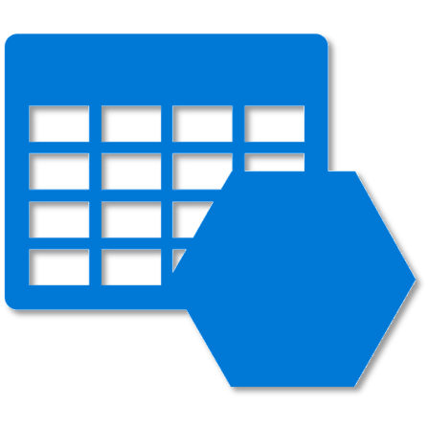
Microsoft Defender for Cloud for Storage
Microsoft Defender for Cloud for Storage is an Azure-native layer of security intelligence that detects unusual and potentially harmful attempts to access or exploit your storage accounts. It utilizes the advanced capabilities of security AI and Microsoft Threat Intelligence to provide contextual security alerts and recommendations.
Security alerts are triggered when anomalies in activity occur. These alerts are integrated with Microsoft Defender for Cloud, and are also sent via email to subscription administrators, with details of suspicious activity and recommendations on how to investigate and remediate threats.
Microsoft Defender for Cloud for Storage alerts customers also upon the detection of malicious activities such as:
Upload of potential malware (using hash reputation analysis).
Phishing campaigns hosted on a storage account.
Access from suspicious IP addresses, such as TOR exit nodes.

Slide 21
Availability
Microsoft Defender for Cloud for Storage is currently available for:
Blob storage
Azure Files
Azure Data Lake Storage Gen2.
Account types that support Microsoft Defender for Cloud include:
General-purpose v2
Block blob
Blob storage accounts.
Microsoft Defender for Cloud for Storage is available in all public clouds and US government clouds, but not in other sovereign or Azure Government cloud regions.
Accounts with hierarchical namespaces enabled for Data Lake Storage support transactions using both the Azure Blob storage APIs and the Data Lake Storage APIs.
Azure file shares support transactions over SMB.

Slide 22
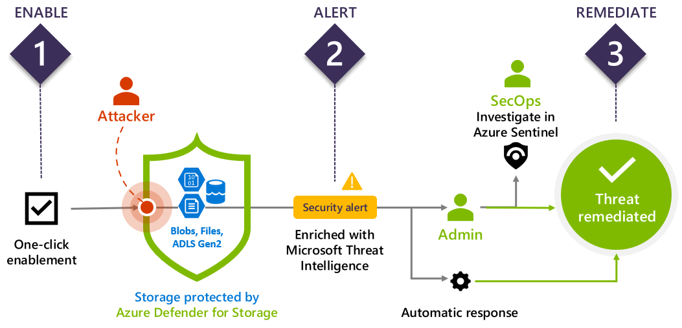
How it works
Rich detection suite - Powered by Microsoft Threat Intelligence, the detections in Defender for Storage cover the top storage threats such as anonymous access, compromised credentials, social engineering, privilege abuse, and malicious content.

Slide 23
Type of Alerts
Security alerts are triggered when there is:
Suspicious access patterns - such as successful access from a Tor exit node or from an IP considered suspicious by Microsoft Threat Intelligence
Suspicious activities - such as anomalous data extraction or unusual change of access permissions
Upload of malicious content - such as potential malware files (based on hash reputation analysis) or hosting of phishing content
Alerts include details of the incident that triggered them, as well as recommendations on how to investigate and remediate threats.
Alerts can be exported to Azure Sentinel or any other third-party SIEM or any other external tool.

Slide 24
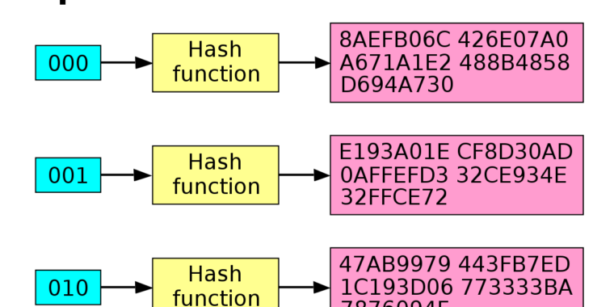
Hash reputation analysis
To determine whether an uploaded file is suspicious, Microsoft Defender for Cloud for Storage uses hash reputation analysis supported by Microsoft Threat Intelligence.
The threat protection tools don’t scan the uploaded files, rather they examine the storage logs and compare the hashes of newly uploaded files with those of known viruses, trojans, spyware, and ransomware.
When a file is suspected to contain malware, Microsoft Defender for Cloud displays an alert and can optionally email the storage owner for approval to delete the suspicious file.
To set up this automatic removal of files that hash reputation analysis indicates contain malware, deploy a workflow automation to trigger on alerts that contain "Potential malware uploaded to a storage account”.

Slide 25
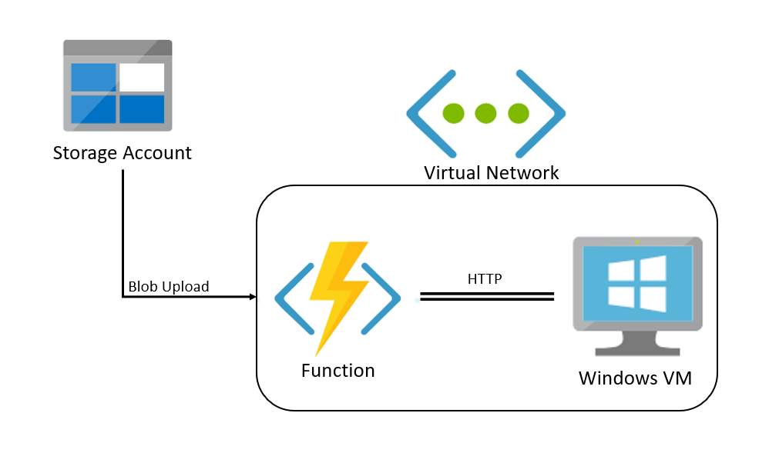
Creative Approach
Create a Virtual Machine with Microsoft Defender for Endpoint and Antivirus
Create a Azure Function that triggers on upload
Do the processing in the VM, delete the file if malicious
https://github.com/Azure/azure-storage-av-automation
Notes:
https://github.com/Azure/azure-storage-av-automation

Slide 26
Microsoft Defender for Cloud for Key Vault

Slide 27

Microsoft Defender for Cloud for Key Vault
Azure Key Vault is a cloud service that safeguards encryption keys and secrets like certificates, connection strings, and passwords.
Enable Microsoft Defender for Cloud for Key Vault for Azure-native, advanced threat protection for Azure Key Vault, providing an additional layer of security intelligence.
Microsoft Defender for Cloud for Key Vault protects applications and credentials, so even if you're familiar with the application or user that triggered the alert, it's important to check the situation surrounding every alert.
Every alert from Microsoft Defender for Cloud for Key Vault, includes the following elements:
Object ID
User Principal Name or IP Address of the suspicious resource

Slide 28
Handling Alerts
Microsoft Defender for Cloud for Key Vault is designed to help identify suspicious activity caused by stolen credentials.
Don't dismiss the alert simply because you recognize the user or application. Contact the owner of the application or the user and verify the activity was legitimate.
You can create a suppression rule to eliminate noise if necessary.
List of all alert types:
https://docs.microsoft.com/en-us/azure/security-center/alerts-reference#alerts-azurekv
Notes:
https://docs.microsoft.com/en-us/azure/security-center/defender-for-key-vault-usage

Slide 29
Thank You slide
Break (15 mins)

Slide 30
Welcome Back!
Kick-Off | 8:00-8:05 | Welcome | Main Call
 | 8:05-8:30 | Attack Patterns + Analysis
 | 8:30-8:45 | Demo Walkthrough
Ingest | 8:45-9:00 | Break
 | 9:00-10:00 | Attack Patterns + Catching Attacks
 | 10:00-11:00 | Activity: Attack Patterns | Table Group Call
 | 11:00-12:00 | Build Hands-on: Attack Simulation
 | 12:00-1:00 | Long Break | Table Group Call
Transform | 1:00-2:00 | Windows Defender, Attack Analysis, Emerging Threats | Main Call
 | 2:00-2:30 | Restoring Systems
 | 2:30-2:45 | Break
 | 2:45-3:15 | Activity: Restoring Systems
 | 3:15-4:00 | Build Hands-on: Restoring Systems | Table Group Call
 | 4:00-4:15 | Closing | Main Call
Presentation/
Whole Group
Lab
Activity/ Discussion/ Group Work
Announcements

Slide 31
Network Map
Notes:
Back to me

Slide 32
Network Map
Provides a graphical view with security overlays giving you recommendations and insights for hardening your network resources.
Using the map you can see the network topology of your Azure workloads, connections between your virtual machines and subnets, and the capability to drill down from the map into specific resources and the recommendations for those resources.
The network map can show you your Azure resources in a Topology view and a Traffic view.

Slide 33
Topology View
In the inner circle, you can see all the Vnets within your selected subscriptions, the next circle is all the subnets, the outer circle is all the virtual machines.
The lines connecting the resources in the map let you know which resources are associated with each other, and how your Azure network is structured.
If there are too many resources being displayed on the map, Microsoft Defender for Cloud uses its proprietary algorithm to smart cluster your resources, highlighting the resources that are in the most critical state, and have the highest severity recommendations.

Slide 34
Traffic View
The Traffic view provides you with a map of all the possible traffic between your resources.
This provides you with a visual map of all the rules you configured that define which resources can communicate with whom.
View existing configuration of the network security groups as well as quickly identify possible risky configurations within your workloads.
The strength of this view is in its ability to show you these allowed connections together with the vulnerabilities that exist, so you can use this cross-section of data to perform the necessary hardening on your resources.
For example, you might detect two machines that you weren’t aware could communicate, enabling you to better isolate the workloads and subnets.

Slide 35
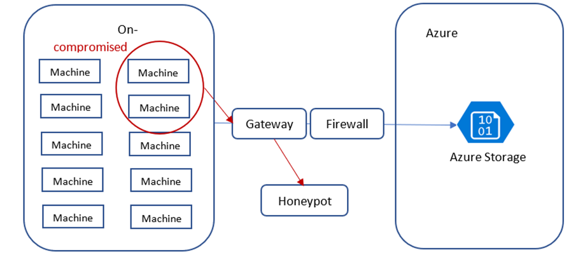
Unwanted Connections - Honey Pots
The strength of this view is in its ability to show you these allowed connections together with the vulnerabilities that exist, so you can use this cross-section of data to perform the necessary hardening on your resources.
For example, you might detect two machines that you weren’t aware could communicate, enabling you to better isolate the workloads and subnets.

Slide 36
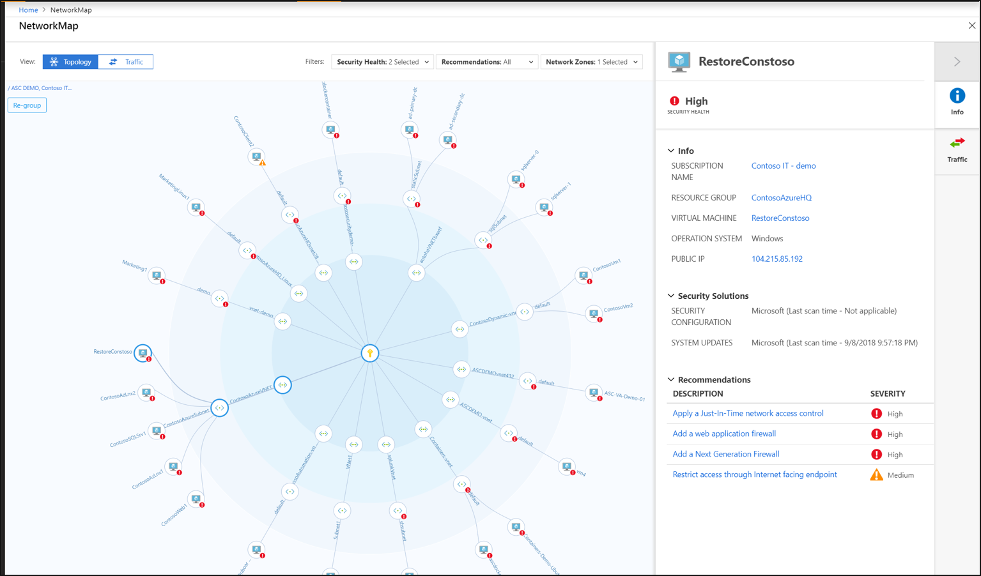
Network Map

Slide 37
IoT Security
Notes:
Back to me

Slide 38
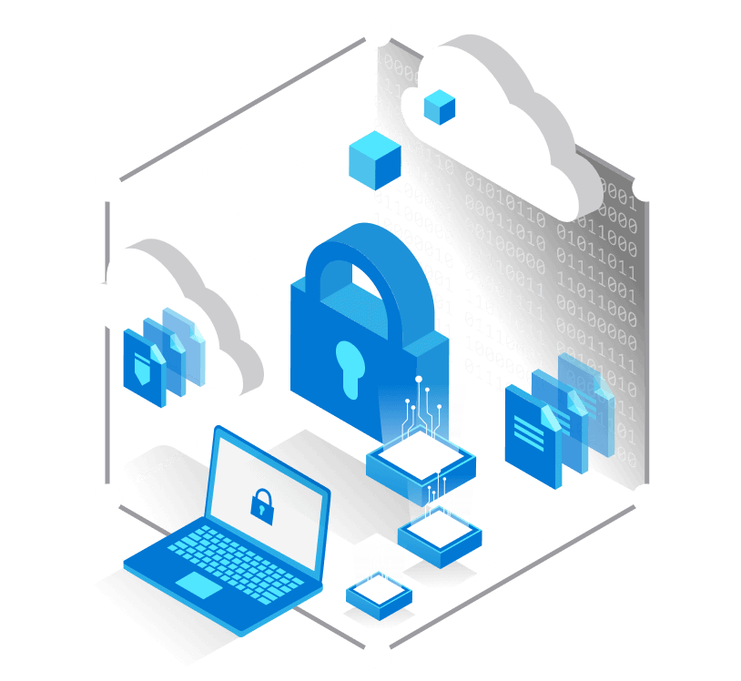
Azure Defender for IoT
Defender for IoT connects both to the Azure cloud and to on-premises components.
The solution is designed for scalability in large and geographically distributed environments with multiple remote locations.
This solution enables a multi-layered distributed architecture by country, region, business unit, or zone.
Provides both agent and agentless solutions with cloud and offline deployments
Notes:
https://docs.microsoft.com/en-us/azure/defender-for-iot/architecture

Slide 39
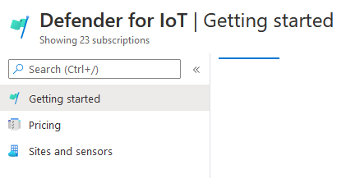
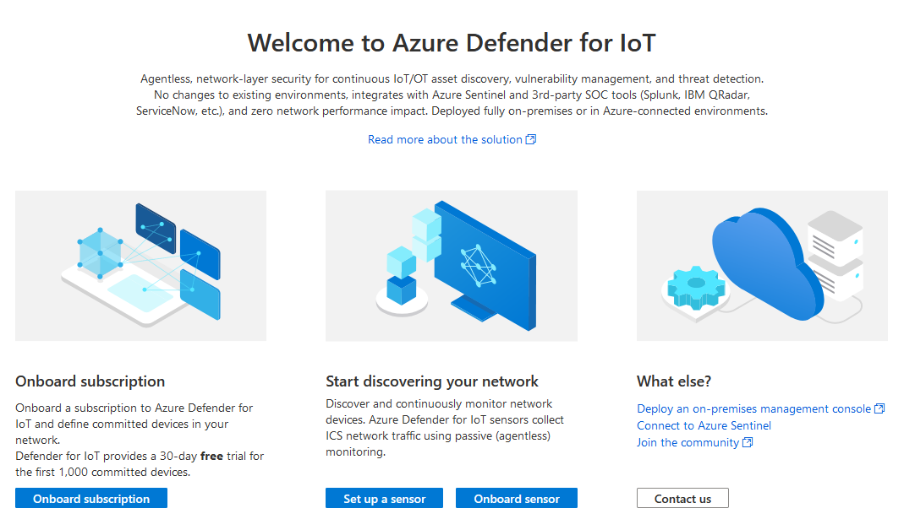
Azure Defender for IoT - Portal
The Microsoft Defender for IoT is a separate Portal outside of the Microsoft Defender for Cloud.
Notes:
https://portal.azure.com/#blade/Microsoft_Azure_IoT_Defender/IoTDefenderDashboard/Getting_Started

Slide 40
Agentless-based (IoT Sensors)
The Defender for IoT sensors discover, and continuously monitor network devices.
Sensors collect ICS network traffic using passive (agentless) monitoring on IoT and OT devices.
Purpose-built for IoT and OT networks, the agentless technology delivers deep visibility into IoT and OT risk within minutes of being connected to the network.
It has zero performance impact on the network and network devices due to its non-invasive, Network Traffic Analysis (NTA) approach.

Slide 41
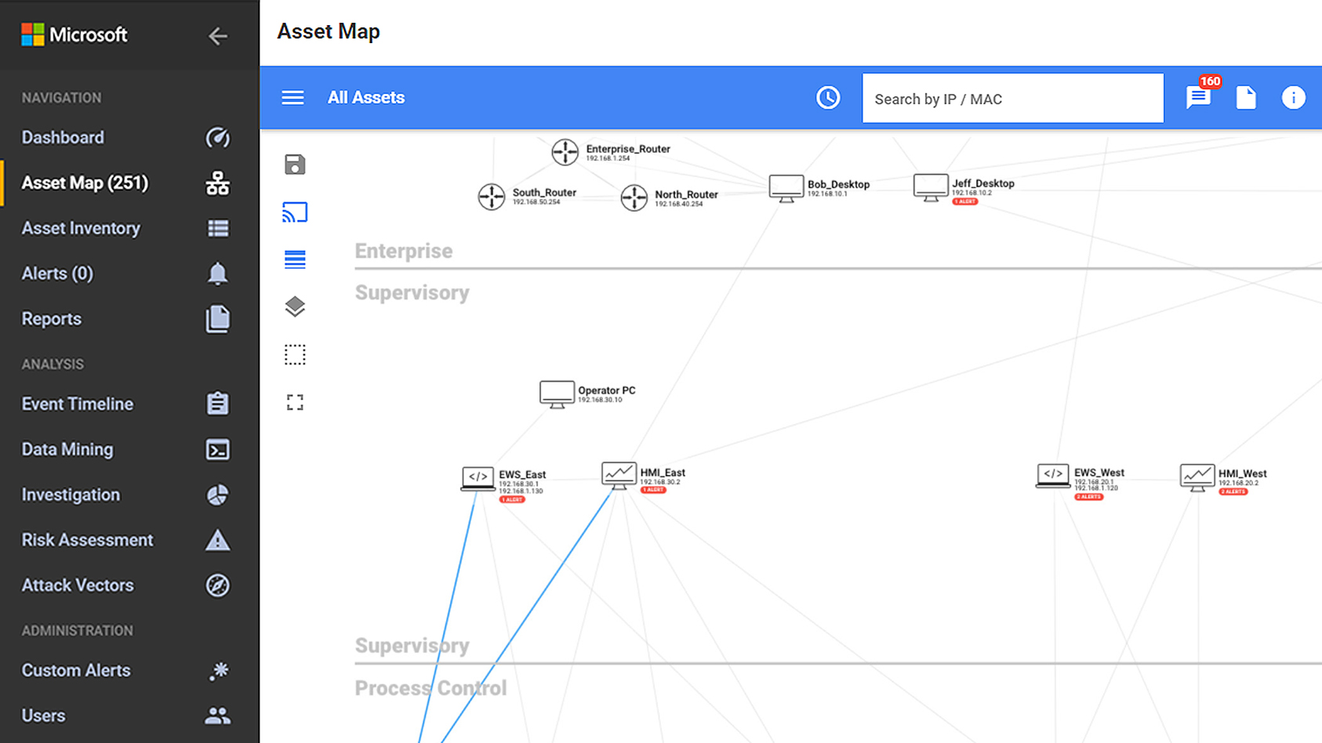
Device Discovery
Use passive, agentless network monitoring to gain a complete inventory of all your IoT/OT assets, with zero impact on the IoT/OT network.
Analyze diverse industrial protocols to identify device details including manufacturer, type, serial number, firmware level, and IP or Media Access Control (MAC) address.
Visualize your entire IoT/OT network topology, see device communication paths, and quickly identify the root cause of operational issues such as misconfigured devices.

Slide 42
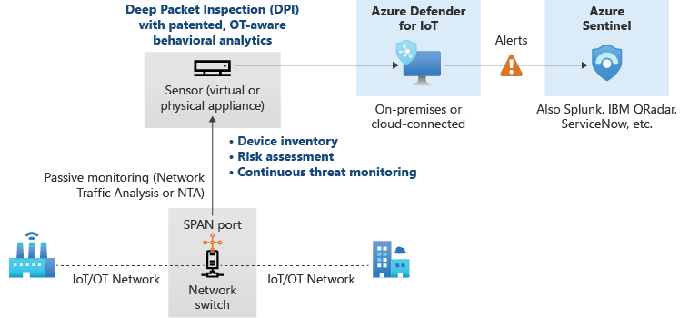
Offline

Slide 43
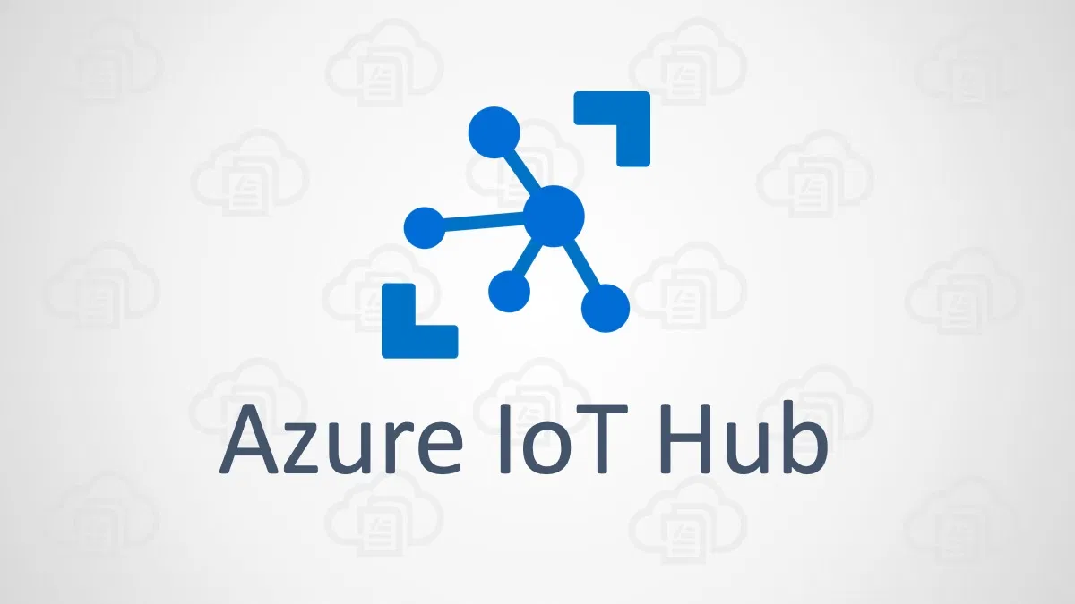
Azure IoT Hub
Enable highly secure and reliable communication between your Internet of Things (IoT) application and the devices it manages.
Azure IoT Hub provides a cloud-hosted solution back end to connect virtually any device.
Extend your solution from the cloud to the edge with per-device authentication, built-in device management, and scaled provisioning.

Slide 44
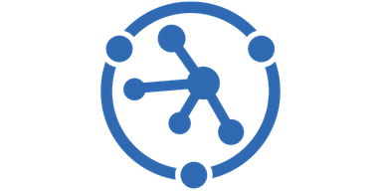
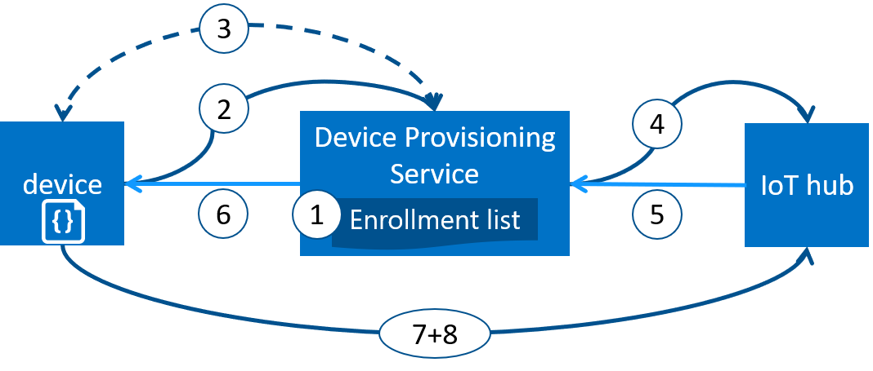
Azure IoT Device Provisioning
Microsoft Azure provides a rich set of integrated public cloud services for all your IoT solution needs. The IoT Hub Device Provisioning Service (DPS) is a helper service for IoT Hub that enables zero-touch, just-in-time provisioning to the right IoT hub without requiring human intervention. DPS enables the provisioning of millions of devices in a secure and scalable manner.

Slide 45
Azure IoT Security Agent
ASC for IoT provides reference architecture for security agents that log, process, aggregate, and send security data through IoT hub. Security agents are designed to work in a constrained IoT environment, and are highly customizable in terms of values they provide when compared to the resources they consume.
Security agents support the following IoT solution features:
Collect raw security events from the underlying OS (Linux, Windows). To learn more about available security data collectors, see ASC for IoT agent configuration.
Aggregate raw security events into messages sent through IoT hub.
Authenticate with existing device identity, or a dedicated module identity.
Configure remotely through use of the atpforiot module twin.
https://github.com/Azure/Azure-IoT-Security-Agent-C

Slide 46
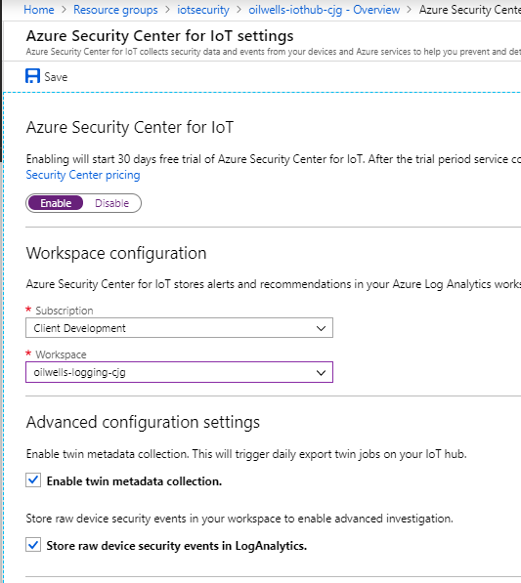
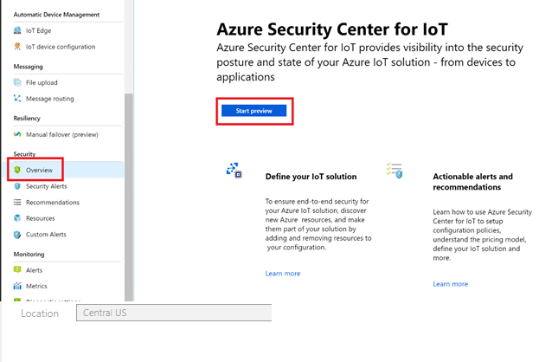
Microsoft Defender for Cloud + IoT Security Agent
Microsoft Defender for Cloud alerts, recommendations and device log data is sent to Log Analytics.

Slide 47
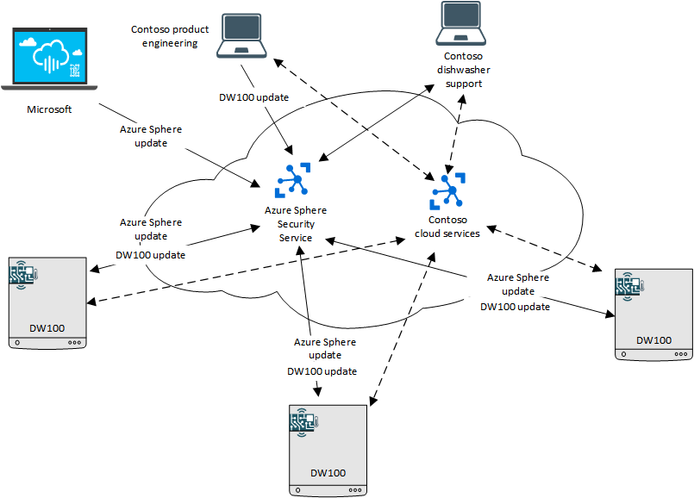
Azure Sphere
Azure Sphere is a secured, high-level application platform with built-in communication and security features for internet-connected devices.
It comprises a secured, connected, crossover microcontroller unit (MCU), a custom high-level Linux-based operating system (OS), and a cloud-based security service that provides continuous, renewable security.
Notes:
https://docs.microsoft.com/en-us/azure-sphere/product-overview/what-is-azure-sphere

Slide 48
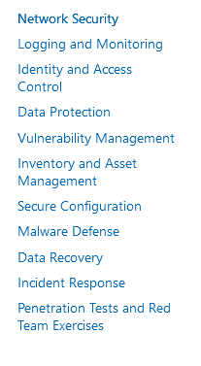
Security Baseline (IoT)
The Azure Security Benchmark provides recommendations on how you can secure your cloud solutions on Azure.
Content is grouped by the security controls defined by the Azure Security Benchmark and the related guidance applicable to Azure IoT Hub.
https://docs.microsoft.com/en-us/security/benchmark/azure/baselines/iot-hub-security-baseline?toc=/azure/iot-hub/TOC.json
Notes:
https://docs.microsoft.com/en-us/security/benchmark/azure/baselines/iot-hub-security-baseline?toc=/azure/iot-hub/TOC.json

Slide 49
Compliance

Slide 50
Compliance
Microsoft Defender for Cloud helps streamline the process for meeting regulatory compliance requirements, using the regulatory compliance dashboard.
Microsoft Defender for Cloud continuously assesses your hybrid cloud environment to analyze the risk factors according to the controls and best practices in the standards applied to your subscriptions. The dashboard reflects the status of your compliance with these standards.
When you enable Microsoft Defender for Cloud on an Azure subscription, the Azure Security Benchmark is automatically assigned to that subscription. This widely respected benchmark builds on the controls from the Center for Internet Security (CIS) and the National Institute of Standards and Technology (NIST) with a focus on cloud-centric security.

Slide 51
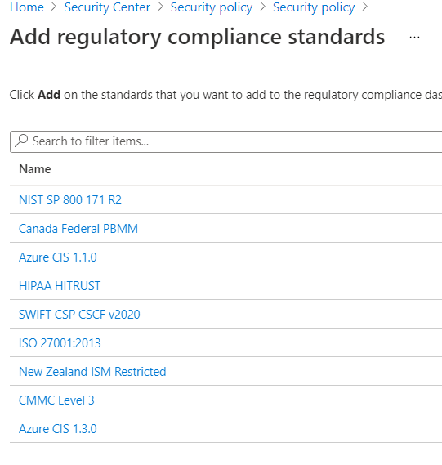
Supported Standards
By default, the regulatory compliance dashboard shows you the Azure Security Benchmark.
The Azure Security Benchmark is the Microsoft-authored, Azure-specific guidelines for security, and compliance best practices based on common compliance frameworks.
To track your compliance with any other standard, you'll need to explicitly add them to your dashboard.
You can add other standards such as Azure CIS 1.3.0, NIST SP 800-53, NIST SP 800-171, SWIFT CSP CSCF-v2020, UK Official and UK NHS, HIPAA, Canada Federal PBMM, ISO 27001, SOC2-TSP, and PCI-DSS 3.2.1.

Slide 52
Dashboard Updates
After you take action to resolve recommendations, wait 12 hours to see the changes to your compliance data.
Assessments are run approximately every 12 hours, so you will see the effect on your compliance data only after the assessments run.

Slide 53
Permissions
To view compliance data, you need to have at least Reader access to the policy compliance data so Security Reader alone won’t suffice.
If you're a global reader on the subscription, that will be enough too.
The minimum set of roles for accessing the dashboard and managing standards is Resource Policy Contributor and Security Admin.

Slide 54
Breakout Activity: Microsoft Defender for Cloud for App Services
As a result of participating in this activity, you will better be able to Use Microsoft Defender to protect PaaS services
OUTCOMES
ACTIVITY
30 minutes
Learning Adviser
Table Group Channel
As a team review WWI requirements provided in student guide
Open the whiteboard and as a team answer the provided challenge questions.
The questions are pre-loaded into the whiteboard.
Welcome | Keynote | Demo Walkthrough | Break | Attack Patterns + Catching Attacks | Activity: Attack Patterns | Break | Lab: Attack Simulation | Long Break | Windows Defender, Attack Analysis, Threats | Restoring Systems | Activity: Restoring Systems | Lab: Restoring Systems | Closing

Slide 55
Build Hands-on Lab: Microsoft Defender for Cloud (Part III)
As a result of participating in this lab, you will be better able to Perform Attack Simulation
OUTCOMES
ACTIVITY
60 minutes
Independent
Table Group Channel & CloudLabs Environment
Independently review and complete Exercises 1-4 in the Lab 1 Guide.
Login to your CloudLabs environment and work through a set of tasks you would typically follow in work associated with ingesting and integrating your customer’s data.
The Lab Guide is available in the ‘Files’ tab of the General channel. Engage your Table Group call for support and troubleshooting.
Welcome | Keynote | Demo Walkthrough | Break | Data Loading & Data Lake Organization | Activity: Data Lake Design & Security Considerations | Break | Lab: Data Integration Part 1 | Break | Data Transformations | Activity: Data Engineering Discussion | Lab: Data Integration Part 2 | Closing

Slide 56
Thank You slide
Long Break (60 mins)

Slide 57
Welcome Back!
Kick-Off | 8:00-8:05 | Welcome | Main Call
 | 8:05-8:30 | Attack Patterns + Analysis
 | 8:30-8:45 | Demo Walkthrough
Ingest | 8:45-9:00 | Break
 | 9:00-10:00 | Attack Patterns + Catching Attacks
 | 10:00-11:00 | Activity: Attack Patterns | Table Group Call
 | 11:00-12:00 | Build Hands-on: Attack Simulation
 | 12:00-1:00 | Long Break | Table Group Call
Transform | 1:00-2:00 | Windows Defender, Attack Analysis, Emerging Threats | Main Call
 | 2:00-2:30 | Restoring Systems
 | 2:30-2:45 | Break
 | 2:45-3:15 | Activity: Restoring Systems
 | 3:15-4:00 | Build Hands-on: Restoring Systems | Table Group Call
 | 4:00-4:15 | Closing | Main Call
Presentation/
Whole Group
Lab
Activity/ Discussion/ Group Work
Announcements

Slide 58
Attack Patterns and Analysis

Slide 59
MITRE ATT&CK

Slide 60

MITRE ATT&CK
Adversarial Tactics, Techniques, and Common Knowledge (ATT&CK)
MITRE started ATT&CK in 2013 to document common tactics, techniques, and procedures (TTPs) that advanced persistent threats use against Windows enterprise networks.
Globally-accessible knowledge base of adversary tactics and techniques based on real-world observations.
The ATT&CK knowledge base is used as a foundation for the development of specific threat models and methodologies in the private sector, in government, and in the cybersecurity product and service community.
Notes:
MITRE ATT&CK®

Slide 61
Framework Terms
Tactics - Tactics represent the “why” of an ATT&CK technique or sub-technique. It is the adversary’s tactical goal: the reason for performing an action.
Techniques - Techniques represent “how” an adversary achieves a tactical goal by performing an action.
Sub-techniques - more specific description of the adversarial behavior used to achieve a goal. They describe behavior at a lower level than a technique.
Procedures - Procedures are the specific implementation the adversary uses for techniques or sub-techniques. For example, a procedure could be an adversary using PowerShell to inject into lsass.exe to dump credentials by scraping LSASS memory on a victim.
Notes:
MITRE ATT&CK®

Slide 62
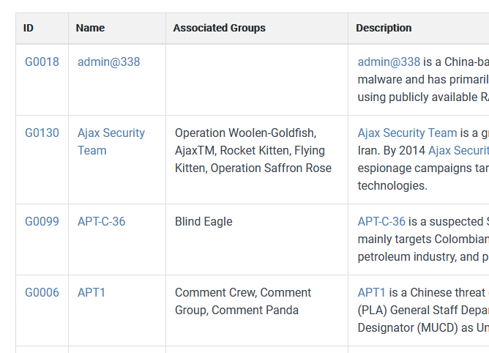
Groups
Groups are sets of related intrusion activity that are tracked by a common name in the security community.
Some groups have multiple names associated with similar activities due to various organizations tracking similar activities by different names.
Organizations' group definitions may partially overlap with groups designated by other organizations and may disagree on specific activity.
Common groups : FIN7, Carbanak (Carbon Spider)
Notes:
https://attack.mitre.org/groups/
Fin7 - https://attack.mitre.org/groups/G0046/
Carbanak - https://attack.mitre.org/groups/G0008/

Slide 63
Enterprise Techniques
Reconnaissance (TA0043) - The adversary is trying to gather information they can use to plan future operations.
Resource Development (TA0042) - The adversary is trying to establish resources they can use to support operations.
Initial Access (TA0027) - The adversary is trying to get into your network.
Execution (TA0041) -The adversary is trying to run malicious code.
Persistence (TA0028) - The adversary is trying to maintain their foothold.
Privilege Escalation (TA0029) - The adversary is trying to gain higher-level permissions.
Defense Evasion (TA0030) -The adversary is trying to avoid being detected.
Credential Access (TA0031) - The adversary is trying to steal account names and passwords.

Slide 64
Enterprise Techniques (Cont)
Discovery (TA0032) - The adversary is trying to figure out your environment.
Lateral Movement (TA0033) - The adversary is trying to move through your environment.
Collection (TA0035) - The adversary is trying to gather data of interest to their goal.
Command and Control (TA0037) - The adversary is trying to communicate with compromised systems to control them.
Exfiltration (TA0036) - The adversary is trying to steal data.
Impact (TA0034) - The adversary is trying to manipulate, interrupt, or destroy your systems and data.
Network Effects (TA0038) - The adversary is trying to intercept or manipulate network traffic to or from a device.
Remote Service Effects (TA0039) - The adversary is trying to control or monitor the device using remote services.

Slide 65
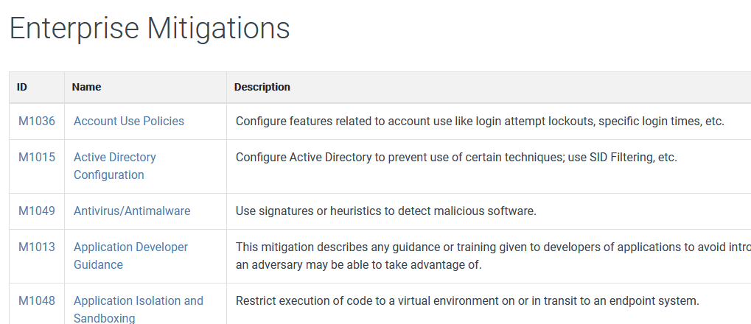
Mitigations
Mitigations are defined and attached to the various techniques and sub-techniques.
Notes:
https://attack.mitre.org/mitigations/enterprise/

Slide 66


Question…
Where are places where MITRE Attack Framework is referenced across Microsoft?
Notes:
You can find MITRE references across most of the Microsoft Security portals:
Microsoft Defender for Cloud
Azure Sentinel
Microsoft Defender 365 Portals

Slide 67
Attack Patterns

Slide 68
Attack Patterns
Malware is a term used to describe malicious applications and code that can cause damage and disrupt normal use of devices.
Malware can allow unauthorized access, use system resources, steal passwords, lock you out of your computer and ask for ransom, and more.
Cybercriminals that distribute malware are often motivated by money and will use infected computers to launch attacks, obtain banking credentials, collect information that can be sold, sell access to computing resources, or extort payment from victims.
Notes:
https://docs.microsoft.com/en-us/windows/security/threat-protection/intelligence/understanding-malware

Slide 69
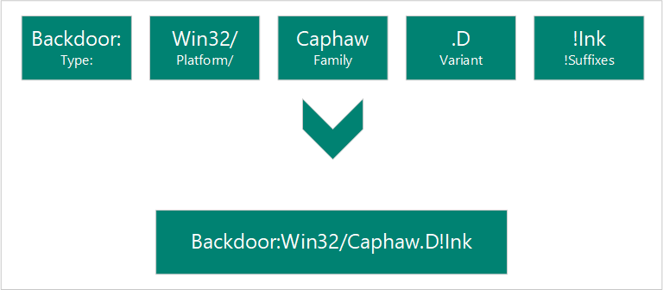
Malware Naming
Computer Antivirus Research Organization (CARO)
Components (Type, Platform, Family, Variant, !Suffixes)
Notes:
https://docs.microsoft.com/en-us/windows/security/threat-protection/intelligence/malware-naming

Slide 70
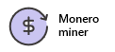
Coin Miners
Mining is the process of running complex mathematical calculations necessary to maintain the blockchain ledger. This process generates coins but requires significant computing resources.
Coin miners aren't inherently malicious.
These coin miners aren't wanted in enterprise environments because they eat up precious computing resources.
Cybercriminals see an opportunity to make money by running malware campaigns that distribute, install, and run trojanized miners at the expense of other people’s computing resources.
Example:
Trojan:Win32/Coinminer
Exploit:O97M/DDEDownloader.PA
Trojan:PowerShell/Maponeir.A
Notes:
Coin miners - Windows security | Microsoft Docs

Slide 71
Exploits and exploit kits
Exploits are often the first part of a larger attack.
Hackers scan for outdated systems that contain critical vulnerabilities, which they then exploit by deploying targeted malware.
Exploits often include shellcode, which is a small malware payload used to download additional malware from attacker-controlled networks.
Shellcode allows hackers to infect devices and infiltrate organizations.
Exploit kits are more comprehensive tools that contain a collection of exploits. These kits scan devices for different kinds of software vulnerabilities and, if any are detected, deploy additional malware to further infect a device.
Kits can use exploits targeting a variety of software, including Adobe Flash Player, Adobe Reader, Internet Explorer, Oracle Java, and Sun Java.
Notes:
Exploits and exploit kits - Windows security | Microsoft Docs

Slide 72
Exploits Naming
A project called "Common Vulnerabilities and Exposures (CVE)" is used by many security software vendors.
The project gives each vulnerability a unique number
For example, CVE-2016-0778.
The portion "2016" refers to the year the vulnerability was discovered.
The "0778" is a unique ID for this specific vulnerability.
https://cve.mitre.org/
Notes:
Exploits and exploit kits - Windows security | Microsoft Docs
https://cve.mitre.org/

Slide 73
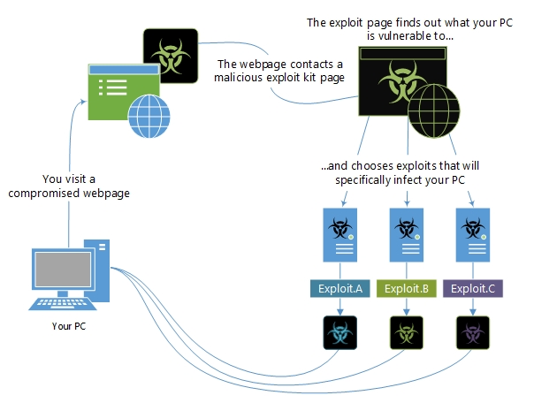
Exploits and exploit kits

Slide 74
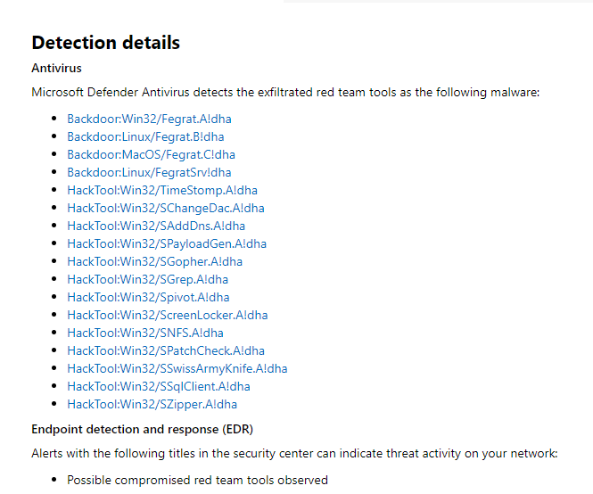
Exploits and exploit kits - FireEye
FireEye revealed that a highly sophisticated actor gained access to their red team tools
https://security.microsoft.com/threatanalytics3/a43fc0c6-120a-40c5-a948-a9f41eef0bf9/analystreport
Notes:
https://security.microsoft.com/threatanalytics3/a43fc0c6-120a-40c5-a948-a9f41eef0bf9/analystreport

Slide 75
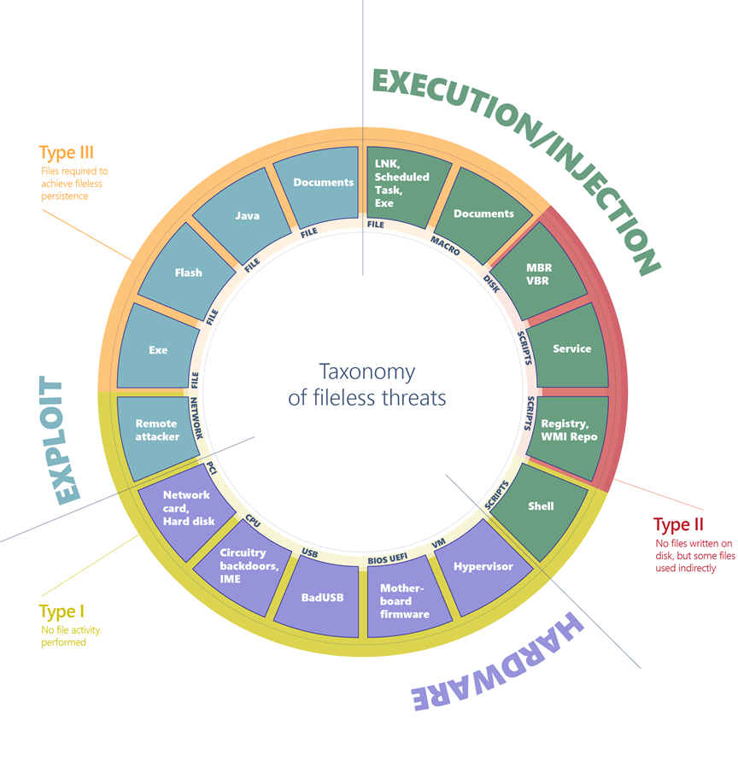
Fileless threats
Type I: No file activity performed
Type II: Indirect file activity
Type III: Files required to operate
Notes:
https://docs.microsoft.com/en-us/windows/security/threat-protection/intelligence/fileless-threats

Slide 76
Type I
A fully fileless malware can be considered one that never requires writing a file on the disk.
All these examples don't require a file on the disk to run, and can theoretically live only in memory. Infections of this type can be particularly difficult to detect because most antivirus products don’t have the capability to inspect firmware.
The malicious code would survive reboots, disk reformats, and OS reinstalls.
Example : Target machine receives malicious network packets that exploit the EternalBlue vulnerability. The vulnerability allows the installation of the DoublePulsar backdoor, which ends up residing only in the kernel memory. In this case, there's no file or any data written on a file.
Example : A compromised device may also have malicious code hiding in device firmware (such as a BIOS), a USB peripheral (like the BadUSB attack), or in the firmware of a network card.
Notes:
https://docs.microsoft.com/en-us/windows/security/threat-protection/intelligence/fileless-threats

Slide 77
Type II
There are other ways that malware can achieve fileless presence on a machine without requiring significant engineering effort. Fileless malware of this type doesn't directly write files on the file system, but they can end up using files indirectly.
Example : the Poshspy backdoor install a malicious PowerShell command within the WMI repository and configured a WMI filter to run the command periodically.
It’s possible to carry out such installation via command line without requiring a backdoor to already be on the file.
The malware can be installed and theoretically run without ever touching the file system.
However, the WMI repository is stored on a physical file in a central storage area managed by the CIM Object Manager, and usually contains legitimate data.
Notes:
https://docs.microsoft.com/en-us/windows/security/threat-protection/intelligence/fileless-threats

Slide 78
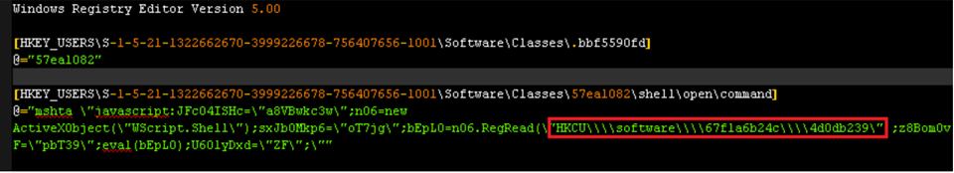
Type III
Some malware can have a sort of fileless persistence, but not without using files to operate.
Example: Kovter creates a shell open verb handler in the registry for a random file extension. Opening a file with such extension will lead to the execution of a script through the legitimate tool mshta.exe.
Notes:
https://docs.microsoft.com/en-us/windows/security/threat-protection/intelligence/fileless-threats

Slide 79
Macro malware
Macro malware hides in Microsoft Office files and is delivered as email attachments or inside ZIP files.
These files use names that are intended to entice or scare people into opening them.
They often look like invoices, receipts, legal documents, and more.
Macro malware was fairly common several years ago because macros ran automatically whenever a document was opened.
In recent versions of Microsoft Office, macros are disabled by default.
Notes:
Macro malware - Windows security | Microsoft Docs

Slide 80
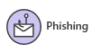
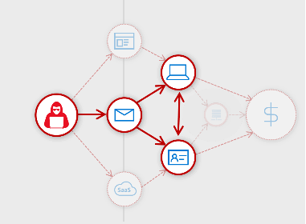
Phishing
Phishing attacks attempt to steal sensitive information through emails, websites, text messages, or other forms of electronic communication.
They try to look like official communication from legitimate companies or individuals.
Cybercriminals often attempt to steal usernames, passwords, credit card details, bank account information, or other credentials.
They use stolen information for malicious purposes, such as hacking, identity theft, or stealing money directly from bank accounts and credit cards.
Notes:
How to protect against phishing attacks - Windows security | Microsoft Docs

Slide 81
Ransomware
Ransomware is a type of malware that encrypts files and folders, preventing access to important files.
Ransomware attempts to extort money from victims by asking for money, usually in form of cryptocurrencies, in exchange for the decryption key.
Cybercriminals won't always follow through and unlock the files they encrypted.
Once ransomware infects a device, it starts encrypting files, folders, entire hard drive partitions using encryption algorithms like RSA or RC4.

Slide 82
Rootkits
Malware authors use rootkits to hide malware on your device, allowing malware to persist as long as possible.
A successful rootkit can potentially remain in place for years if it's undetected.
During this time, it will steal information and resources.
Rootkits intercept and change standard operating system processes. After a rootkit infects a device, you can’t trust any information that device reports about itself.
Example: If you were to ask a device to list all of the programs that are running, the rootkit might stealthily remove any programs it doesn’t want you to know about.
Notes:
Rootkits - Windows security | Microsoft Docs

Slide 83
Supply chain attacks
Supply chain attacks are an emerging kind of threat that target software developers and suppliers.
The goal is to access source codes, build processes, or update mechanisms by infecting legitimate apps to distribute malware.
Attackers hunt for unsecure network protocols, unprotected server infrastructures, and unsafe coding practices. They break in, change source codes, and hide malware in build and update processes.
Because software is built and released by trusted vendors, these apps and updates are signed and certified.
In software supply chain attacks, vendors are likely unaware that their apps or updates are infected with malicious code when they’re released to the public. The malicious code then runs with the same trust and permissions as the app.

Slide 84
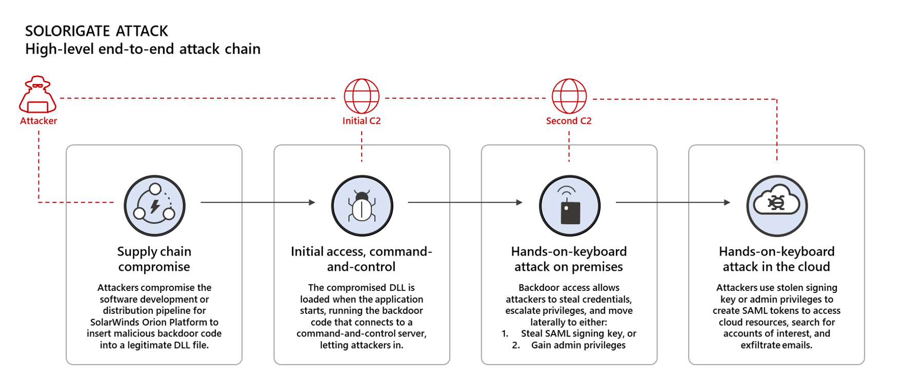
Supply chain attacks - Solorigate
High-level end-to-end attack chain (https://security.microsoft.com/threatanalytics3/2b74f636-146e-48dd-94f6-5cb5132467ca/overview)
Notes:
https://www.microsoft.com/security/blog/2021/01/14/increasing-resilience-against-solorigate-and-other-sophisticated-attacks-with-microsoft-defender/
https://security.microsoft.com/threatanalytics3/2b74f636-146e-48dd-94f6-5cb5132467ca/overview
https://techcommunity.microsoft.com/t5/azure-sentinel/solarwinds-post-compromise-hunting-with-azure-sentinel/ba-p/1995095

Slide 85
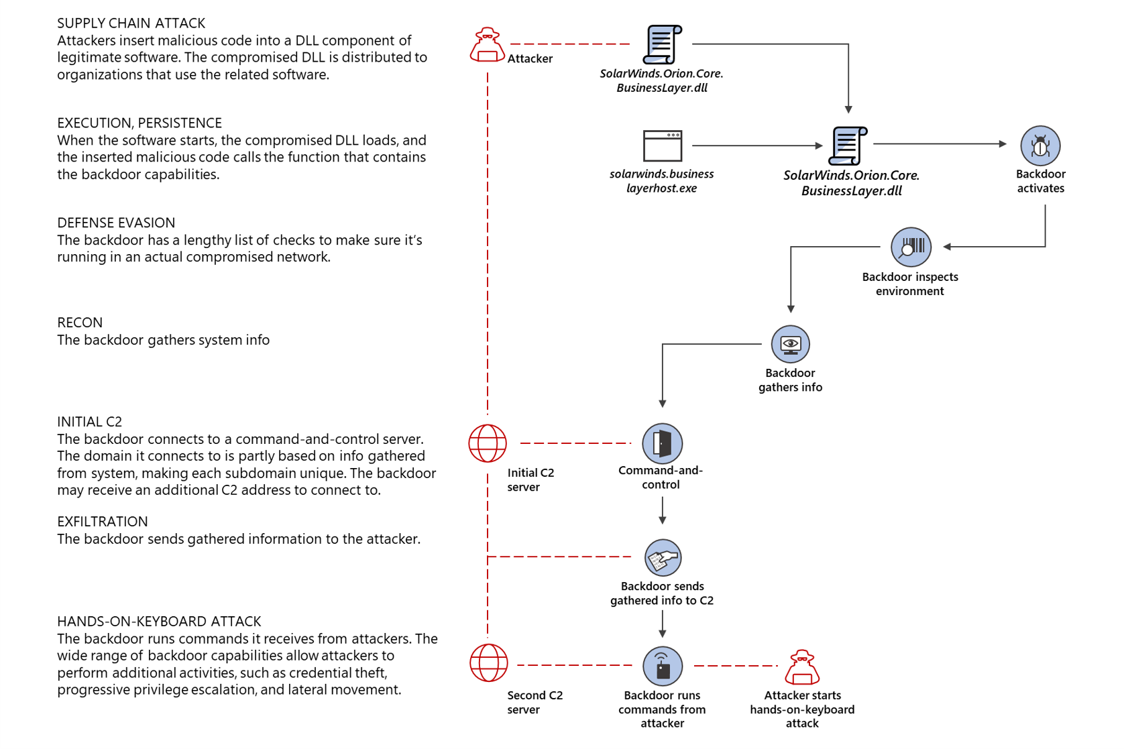
Supply chain attacks - Solorigate
High-level end-to-end attack chain (https://security.microsoft.com/threatanalytics3/2b74f636-146e-48dd-94f6-5cb5132467ca/overview)
Notes:
https://www.microsoft.com/security/blog/2021/01/14/increasing-resilience-against-solorigate-and-other-sophisticated-attacks-with-microsoft-defender/
https://security.microsoft.com/threatanalytics3/2b74f636-146e-48dd-94f6-5cb5132467ca/overview
https://techcommunity.microsoft.com/t5/azure-sentinel/solarwinds-post-compromise-hunting-with-azure-sentinel/ba-p/1995095
https://www.microsoft.com/security/blog/2020/12/18/analyzing-solorigate-the-compromised-dll-file-that-started-a-sophisticated-cyberattack-and-how-microsoft-defender-helps-protect/

Slide 86
Tech support scams
Tech support scams are an industry-wide issue where scammers use scare tactics to trick users into paying for unnecessary technical support services that supposedly fix contrived device, platform, or software problems.
Scammers might also initiate contact by displaying fake error messages on websites you visit, displaying support numbers and enticing you to call.
They can also put your browser on full screen and display pop-up messages that won't go away, essentially locking your browser.

Slide 87
Trojans
Trojans are a common type of malware which, unlike viruses, can’t spread on their own.
This means they either have to be downloaded manually or another malware needs to download and install them.
Trojans often use the same file names as real and legitimate apps.
It is easy to accidentally download a trojan thinking that it is a legitimate app.

Slide 88
Unwanted software
Unwanted software are programs that alter the Windows experience without your consent or control.
This can take the form of modified browsing experience, lack of control over downloads and installation, misleading messages, or unauthorized changes to Windows settings.
Some applications are software bundlers, which means that they are packed with other applications. As a result, other programs can be inadvertently installed when the original application is downloaded.

Slide 89
Potentially unwanted application (PUA)
PUAs are not considered malware
Advertising software
Torrent software
Cyptomining software
Bundling software
Marketing software
Evasion software
Poor industry reputation
Notes:
https://docs.microsoft.com/en-us/windows/security/threat-protection/intelligence/criteria

Slide 90
Worms
A worm is a type of malware that can copy itself and often spreads through a network by exploiting security vulnerabilities.
It can spread through email attachments, text messages, file-sharing programs, social networking sites, network shares, removable drives, and software vulnerabilities.
Jenxcus (also known as Dunihi), Gamarue (also known as Androm), and Bondat have consistently remained at the top of the list of malware that infects users running Microsoft software.
Notes:
Worms - Windows security | Microsoft Docs

Slide 91
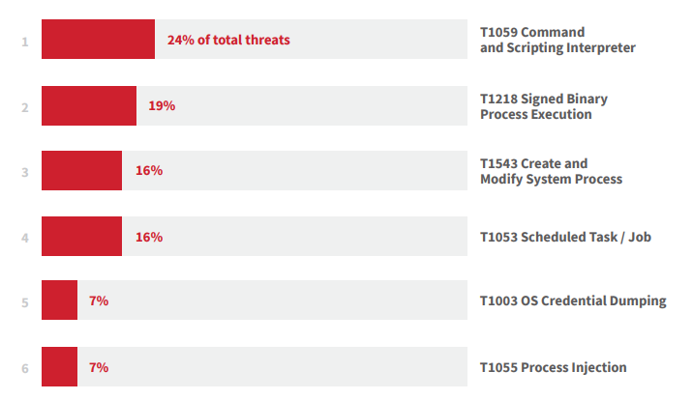
Top Threats 2021

Slide 92
T1059 – Command and Scripting Interpreter
PowerShell is an automation and configuration management framework which expands its capabilities beyond other common command-line and scripting languages. PowerShell is included by default in modern versions of Windows.
Adversaries use PowerShell to obfuscate commands in hopes of achieving any of the following:
Evading detection
Spawning additional processes
Downloading and executing remote code and binaries
Gathering information
Changing system configuration
Encoding or obfuscation more than any other variety of malicious or suspicious PowerShell. PowerShell’s flexibility along with its support for aliases, abbreviated cmdlets, argument names, and calling .NET methods offers attackers many ways to invoke Base64 and other encoding.
-e; -ec; -encodecommand; [System.Convert]::FromBase64String()

Slide 93
T1218 – Signed Binary Process Execution
Rundll32 is a native Windows process installed by default. It is a functionally necessary component of the Windows operating system that can’t be simply blocked or disabled.
This necessity and ubiquity makes Rundll32 an attractive target for adversaries.
Often leverage Rundll32 to load code from DLLs within world writable directories (such as Windows temp directory), a pattern of behavior that you might see from legitimate enterprise software as well as not-so-legit tools like Cobalt Strike.
Example 1 : Use Rundll32 to load the legitimate comsvcs.dll, which calls the MiniDump function, allowing adversaries to dump the memory of certain processes (like lsass.exe).
Example 2 : A legitimate function of Rundll32 that is used for a variety of reasons. Several threats (such as Qbot, Dridex, ,Egregor and Maze) can leverage it as a mechanism to bypass application controls.
Example 3 : Cobalt Strike leverages the StartW function to load DLLs from the command line.

Slide 94
T1543 – Create and Modify System Process
Windows services are imperative to the normal functions of the operating system.
They are common binaries that run in the background and are typically not cause for alarm when executed.
Since Windows services already exist on the system, an adversary who is able to modify or install a new service is less likely to draw attention to their activities than an adversary who installs and runs an unknown binary or spawns a command from a command or scripting interpreter.
A common pattern is the use of the Windows Service Control Manager Configuration Tool (sc.exe) to modify or create a service.
Example: Blue Mockingbird, an activity cluster that deploys Monero cryptocurrency-mining payloads and leverages Windows services for persistence.

Slide 95
T1053 – Scheduled Task / Job
Adversaries use scheduled tasks to accomplish two primary objectives, maintaining access and executing processes in a specific user context. Typically, one is with elevated privileges.
As a wide variety of legitimate software uses scheduled tasks for an even wider variety of legitimate reasons, malicious use often blends in with innocuous use.
Scheduled tasks are a functionally necessary component of the Windows operating system that can’t just be turned off or blocked.
Most attacks include the /Create flag, which makes sense for adversaries wanting to establish persistence.

Slide 96
T1003 – OS Credential Dumping
Attackers attempt to dump credentials to obtain account login and credential material, normally in the form of a hash or a clear text password, from the operating system and software.
Credentials can then be used to perform Lateral Movement and access restricted information.
Example : The Local Security Authority Subsystem Service (LSASS) is commonly used by attackers looking to steal sensitive credentials, with a little help from administrative tools such as ProcDump or tools like Mimikatz.
Upon starting up, LSASS contains valuable authentication data such as:
Encrypted passwords
NT hashes
LM hashes
Kerberos tickets

Slide 97
Question…
How would you mitigate T1059?
Notes:
You can utilize any of the following mitigations:
M1049 Antivirus/Antimalware Anti-virus can be used to automatically quarantine suspicious files.
M1045 Code Signing Where possible, only permit execution of signed scripts.
M1042 Disable or Remove Feature or Program Disable or remove any unnecessary or unused shells or interpreters.
M1038 Execution Prevention Use application control where appropriate.
M1026 Privileged Account Management When PowerShell is necessary, restrict PowerShell execution policy to administrators. Be aware that there are methods of bypassing the PowerShell execution policy, depending on environment configuration.^{[37]}
M1021 Restrict Web-Based Content Script blocking extensions can help prevent the execution of scripts and HTA files that may commonly be used during the exploitation process. For malicious code served up through ads, adblockers can help prevent that code from executing in the first place.

Slide 98
Emerging Threats

Slide 99
OASIS

Slide 100
OASIS CTI TC
Organization for the Advancement of Structured Information Standards (OASIS)
Cyber Threat Intelligence (CTI) Technical Committee (TC)
Individuals, organizations, and governments come together to solve some of the world’s biggest technical challenges through the development of open code and open standards.
In charge of the STIX and TAXII standards.
Notes:
OASIS Open - OASIS Open (oasis-open.org)

Slide 101
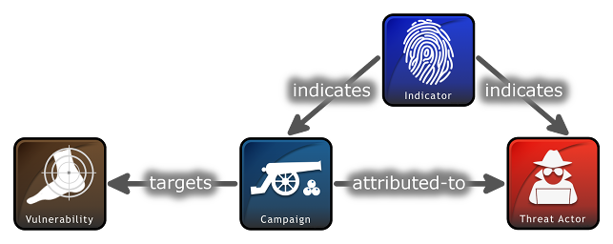
Structured Threat Information Expression (STIX™)
STIX, which was originally sponsored by the office of Cybersecurity and Communications within the United States Department of Homeland Security (DHS).
With STIX, all aspects of suspicion, compromise and attribution can be represented clearly with objects and descriptive relationships.
STIX information can be visually represented for an analyst or stored as JSON to be quickly machine readable. STIX's openness allows for integration into existing tools and products or utilized for your specific analyst or network needs.
STIX Objects categorize each piece of information with specific attributes to be populated. Chaining multiple objects together through relationships allow for easy or complex representations of CTI.
Notes:
Introduction to STIX (oasis-open.github.io)

Slide 102
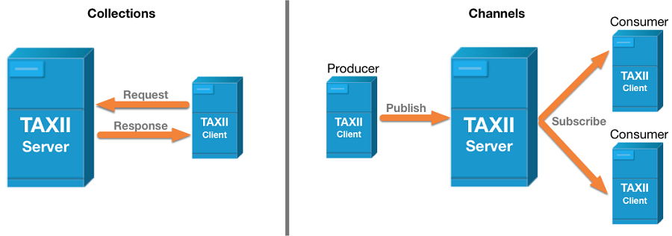
TAXII
Trusted Automated Exchange of Intelligence Information (TAXII™) is an application protocol for exchanging CTI over HTTPS.
Collection is an interface to a logical repository of CTI objects provided by a TAXII Server that allows a producer to host a set of CTI data that can be requested by consumers.
Maintained by a TAXII Server, a Channel allows producers to push data to many consumers and consumers to receive data from many producers

Slide 103
Question…
Which Microsoft product supports ingestion of STIX/TAXII feeds?
Notes:
Azure Sentinel
https://docs.microsoft.com/en-us/azure/sentinel/import-threat-intelligence

Slide 104
Breakout Activity: Attack Patterns
As a result of participating in this activity, you will better be able to Understand Attack Patterns
OUTCOMES
ACTIVITY
30 minutes
Learning Adviser
Table Group Channel
As a team review WWI requirements provided in student guide
Open the whiteboard and as a team answer the provided challenge questions.
The questions are pre-loaded into the whiteboard.
Welcome | Keynote | Demo Walkthrough | Break | Attack Patterns + Catching Attacks | Activity: Attack Patterns | Break | Lab: Attack Simulation | Long Break | Windows Defender, Attack Analysis, Threats | Restoring Systems | Activity: Restoring Systems | Lab: Restoring Systems | Closing

Slide 105

Full Group Activity: Attack Patterns
Objective: As a result of participating in this activity, you will better be able to answer questions about the product(s).
What you will be doing: The facilitator will be posting questions to the entire group using an interactive tool called Mentimeter. The answers you post using Mentimeter will then drive the discussion.
Total Activity Time: 30 minutes

Slide 106

Mentimeter Poll
Scan QR Code
or Go to www.menti.com and use code
1183 9575
Notes:
https://www.menti.com/9r2wwujwag

Slide 107
Build Hands-on Lab: Attack Simulation
As a result of participating in this lab, you will be better able to Perform Attack Simulation
OUTCOMES
ACTIVITY
60 minutes
Independent
Table Group Channel & CloudLabs Environment
Independently review and complete Exercises 1-4 in the Lab 1 Guide.
Login to your CloudLabs environment and work through a set of tasks you would typically follow in work associated with ingesting and integrating your customer’s data.
The Lab Guide is available in the ‘Files’ tab of the General channel. Engage your Table Group call for support and troubleshooting.
Welcome | Keynote | Demo Walkthrough | Break | Data Loading & Data Lake Organization | Activity: Data Lake Design & Security Considerations | Break | Lab: Data Integration Part 1 | Break | Data Transformations | Activity: Data Engineering Discussion | Lab: Data Integration Part 2 | Closing

Slide 108
Preparing For The Worse

Slide 109
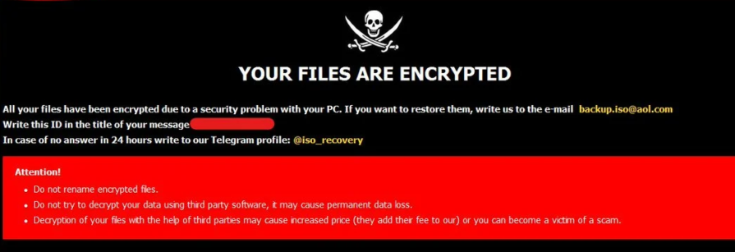
Bad Things Happen
Threats continue to be created and old threats evolve.
Supply chain attacks are proving to be the most destructive (Solarwinds)
Bad Things can still happen.

Slide 110
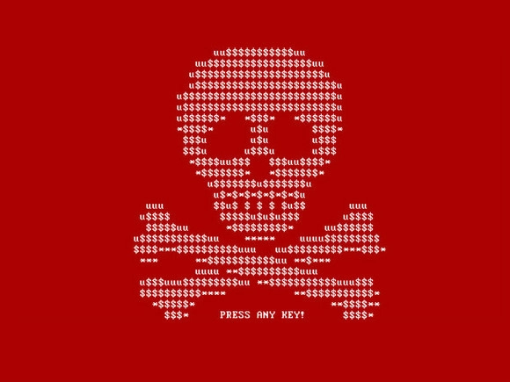
Ransomware
In 2020, the FBI’s Internet Crime Complaint Center received 2,474 ransomware complaints, and those are just the ones that got reported.
Cybersecurity Ventures expects that businesses will fall victim to a ransomware attack every 11 seconds in 2021, up from every 14 seconds in 2019, and every 40 seconds in 2016.
In 2020, the total number of global ransomware reports increased by 485% year-over-year according to the latest Threat Landscape Report 2020 by Bitdefender.

Slide 111
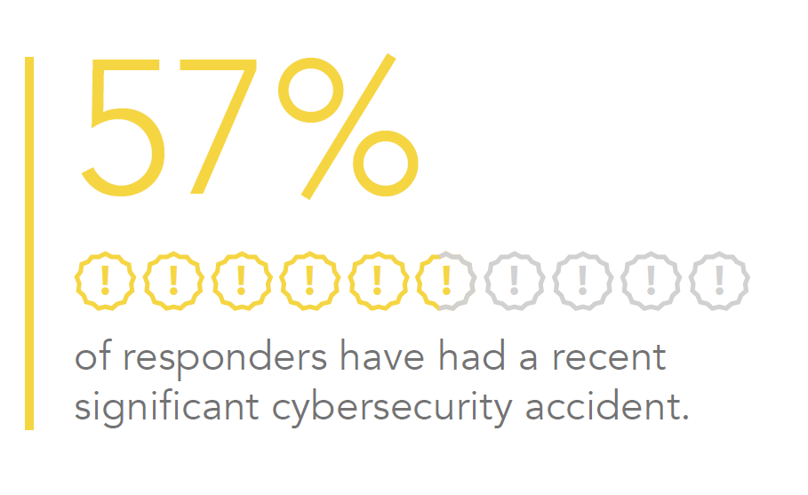
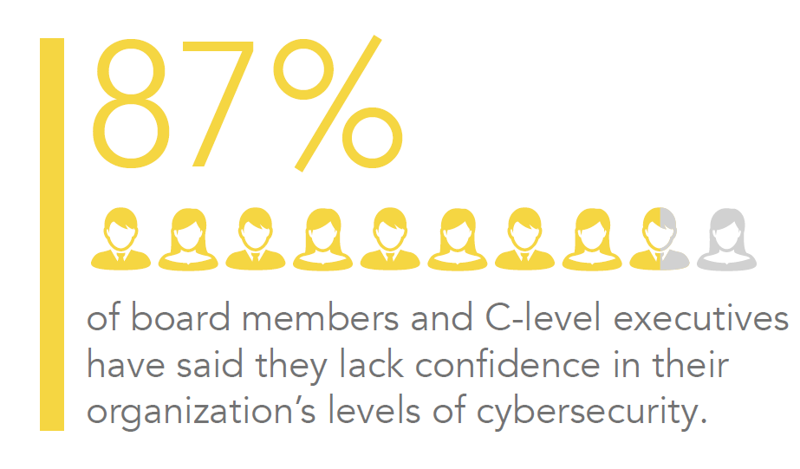
Some Data
Many organizations will experience a major incident or must respond to difficult questions about preventing, detecting, and successfully managing a cybersecurity attack from customers, partners, and the board of directors.
A 2016-2017 EY survey showed that 87% of board members and C-suite members lack confidence in their organization’s level of cybersecurity

Slide 112
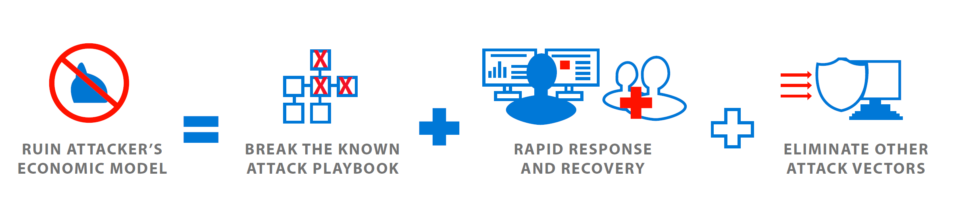
Ransomware (Cont)
A ransomware attack can be devastating for a home or a business.
Valuable and irreplaceable files can be lost and tens or even hundreds of hours of effort can be required to get rid of the infection and get systems working again.
Ransomware attacks continue to evolve and attack methods get more sophisticated all the time.
You don’t have to be part of the statistics. With good planning and smart practices, you can prevent ransomware from affecting your systems.

Slide 113


Slide 114
Prior To An Incident
Appoint a communications lead to be part of the core incident response team and confirm he or she understands the response process and cybersecurity.
Develop a communications portion of existing incident response plans, including clear ownership and approval processes
Map the stakeholders that may need to receive communications regarding an incident including customers, media, partners, regulators, employees and vendors.
Develop draft media holding statements and other materials for the major types of incidents that are of most concern to your company.
Host a table top exercise with members from the entire incident response team to test how they would react to the media, customer, and regulator attention due to an incident

Slide 115
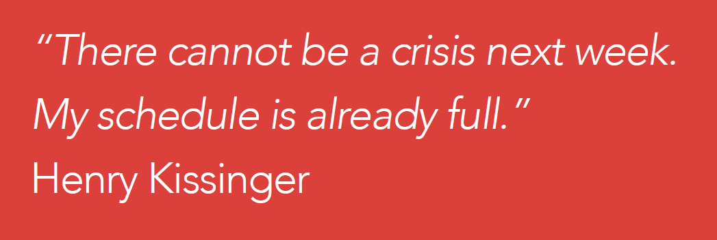

Slide 116
During an Incident
Keep calm – Incidents are extremely disruptive and can become emotionally charged. Stay calm and focus on prioritizing your efforts on the most impactful actions first.
Do no harm – Confirm your response is designed and executed in a way that avoids loss of data, loss of business-critical functionality, and loss of evidence. Avoid decisions can damage your ability to create forensic timelines, identify root cause, and learn critical lessons.
Be Accurate – Confirm anything you share to the public and to customers is correct and truthful.
Get help when needed – Investigating and responding to attacks from sophisticated attackers benefits significantly from deep expertise and experience.

Slide 117
Recovery Process
Isolate the Infection : Prevent the infection from spreading by separating all infected computers from each other, shared storage, and the network.
Identify the Infection : From messages, evidence on the computer, and identification tools, determine which malware strain you are dealing with. Determine its scope and the objective of the attack.
Report : Report to the authorities to support and coordinate measures to counter attack.
Determine Your Options : You have a number of ways to deal with the infection. Determine which approach is best for you.
Restore and Refresh : Use safe backups and program and software sources to restore your computer or outfit a new platform.
Prevent Recurrence : Make an assessment of how the infection occurred and what you can do to put measures into place that will prevent it from happening again.

Slide 118
Isolate the infection
Pull the network plug!
The first thing to do when a computer is suspected of being infected is to isolate it from other computers and storage devices.
Disconnect it from the network (both wired and Wi-Fi) and from any external storage devices.
Cryptoworms actively seek out connections and other computers, so you want to prevent that happening.
You also don’t want the ransomware communicating across the network with its command and control center.
Be aware that there may be more than just one patient zero, meaning that the ransomware may have entered your organization or home through multiple computers, or may be dormant and not yet shown itself on some systems.
Treat all connected and networked computers with suspicion and apply measures to ensure that all systems are not infected.

Slide 119
Identify the infection
Most often the ransomware will identify itself when it asks for ransom.
There are numerous sites that help you identify ransomware, including ID Ransomware.
The No More Ransom! Project provides the Crypto Sheriff to help identify ransomware.
Identifying the ransomware will help you understand what type of ransomware you have, how it propagates, what types of files it encrypts, and maybe what your options are for removal and disinfection.
It also will enable you to report the attack to the authorities, which is recommended.

Slide 120
Report
You’ll be doing everyone a favor by reporting all ransomware attacks to the authorities.
The FBI urges ransomware victims to report ransomware incidents regardless of the outcome.
Victim reporting provides law enforcement with a greater understanding of the threat, provides justification for ransomware investigations, and contributes relevant information to ongoing ransomware cases.
Knowing more about victims and their experiences with ransomware will help the FBI to determine who is behind the attacks and how they are identifying or targeting victims.
You can file a report with the FBI at the Internet Crime Complaint Center.

Slide 121
Legal
Maintain Confidentiality and Protect Privilege. Legal counsel (internal and/or external) should be positioned to direct the investigation and response efforts, generally in close partnership with the IT security lead, to identify legal obligations and manage risk
Identify Legal Statutory, Contractual, and Other Obligations. Statutory legal obligations are constantly shifting as statutory notification obligations are amended and (re)interpreted, changing the data elements and events that trigger notification obligations, and creating so-called notification safe harbors.
Take Care Regarding Post-Breach Actions/Statements. Understanding what to say – and what not to say – is critical to managing legal risk.
Engage Law Enforcement. Engaging law enforcement is now a key consideration in incident response. It is often required depending on industry (for example, certain government contractors) and type of data affected (for example, by major card brands in the case of a credit card breach).
Keep Executives/Board Members Adequately Informed. Increasingly, shareholders and regulators are scrutinizing C-suite and board members involvement in and oversight of cybersecurity incidents.

Slide 122
Determine your options
Your options when infected with ransomware are:
To pay the ransom.
To try to remove the malware.
To wipe the system(s) and reinstall from scratch.
It’s generally considered a bad idea to pay the ransom. Paying the ransom encourages more ransomware, and in many cases the unlocking of the encrypted files is not successful.
In a recent survey, more than three-quarters of respondents said their organization is not at all likely to pay the ransom in order to recover their data (77%). Only a small minority said they were willing to pay some ransom (3% of companies have already set up a Bitcoin account in preparation).
Even if you decide to pay, it’s very possible you won’t get back your data.

Slide 123
Microsoft Defender - Cleaning the Threat
Malware\Ransomware can be cleared, but the damage has probably already occurred
Provided you have the experience you can attempt to remove manually, or alternatively, use tools.
Microsoft provides several tools to prevent infection, but also tools to help remove them:
Microsoft Safety Scanner
Windows Defender Offline

Slide 124
Microsoft Safety Scanner
Microsoft Safety Scanner is a scan tool designed to find and remove malware from Windows computers.
Simply download it and run a scan to find malware and try to reverse changes made by identified threats.
Safety Scanner only scans when manually triggered and is available for use 10 days after being downloaded. We recommend that you always download the latest version of this tool before each scan.
Safety scanner is a portable executable and does not appear in the Windows Start menu or as an icon on the desktop. Note where you saved this download.
This tool does not replace your antimalware product.
Notes:
https://docs.microsoft.com/en-us/windows/security/threat-protection/intelligence/safety-scanner-download

Slide 125
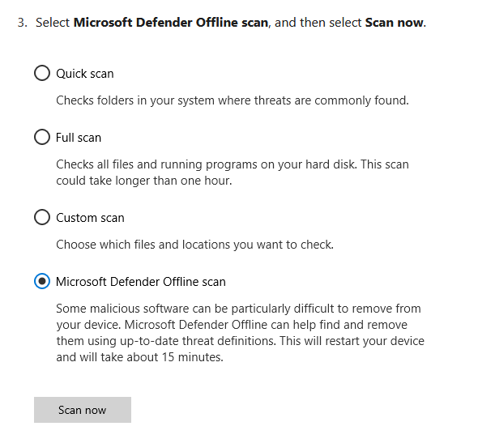
Windows Defender Offline
Microsoft Defender Offline is a powerful offline scanning tool that runs without starting your operating system in order to remove persistent threats.
Sometimes Microsoft Defender Antivirus might find malware that it can’t remove—for example, highly persistent malware such as rootkits.
If that happens, it will prompt you to run Microsoft Defender Offline, which is already installed with Windows 10.

Slide 126
Restore and Refresh
You have the choice of trying to remove the malware from your systems or wiping your systems and reinstalling from safe backups and clean OS and application sources.
The surest way of being certain that malware or ransomware has been removed from a system is to do a complete wipe of all storage devices and reinstall everything from scratch. Formatting the hard disks in your system will ensure that no remnants of the malware remain.
Be sure to determine the date of infection as well as you can from malware file dates, messages, and other information you have uncovered about how your particular malware operates.
Consider that an infection might have been dormant in your system for a while before it activated and made significant changes to your system.
Identifying and learning about the particular malware that attacked your systems will enable you to understand how that malware functions and what your best strategy should be for restoring your systems.

Slide 127
Restore and Refresh (3-2-1-1-0)
Backup files and systems (Azure Backup, OneDrive)
Use the 32110 data protection zip code
3 Different Copies of Data
2 Different Media
1 Offsite copy
1 copy is air-gapped or immutable
0 Errors after backup

Slide 128
Prevent Recurrence
Use anti-virus and anti-malware software or other security policies to block known payloads from launching.
Make frequent, comprehensive backups of all important files and isolate them from local and open networks.
Immutable backup options such as Object Lock offer users a way to maintain truly air-gapped backups. The data is fixed, unchangeable, and cannot be deleted within the time frame set by the end-user. With immutability set on critical data, you can quickly restore uninfected data from your immutable backups, deploy them, and return to business without interruption.
Object Lock functionality for backups allows you to store objects using a Write Once, Read Many (WORM) model, meaning after it’s written, data cannot be modified. Using Object Lock, no one can encrypt, tamper with, or delete your protected data for a specified period of time, creating a solid line of defense against ransomware attacks.

Slide 129
Prevent Recurrence (Cont)
Keep offline backups of data stored in locations inaccessible from any potentially infected computer, such as disconnected external storage drives or the cloud, which prevents them from being accessed by the ransomware.
Install the latest security updates issued by software vendors of your OS and applications. Remember to patch early and patch often to close known vulnerabilities in operating systems, browsers, and web plugins.
Consider deploying security software to protect endpoints, email servers, and network systems from infection.
Exercise cyber hygiene, such as using caution when opening email attachments and links.

Slide 130
Prevent Recurrence (Cont)
Segment your networks to keep critical computers isolated and to prevent the spread of malware in case of attack. Turn off unneeded network shares.
Turn off admin rights for users who don’t require them. Give users the lowest system permissions they need to do their work.
Restrict write permissions on file servers as much as possible.
Educate yourself, your employees, and your family in best practices to keep malware out of your systems. Update everyone on the latest email phishing scams and human engineering aimed at turning victims into abettors.

Slide 131
Question…
What tools can be used to backup on-premises and Azure-based virtual machines?
Notes:
Azure Backup / Recovery Services Vault.
https://docs.microsoft.com/en-us/azure/backup/backup-azure-recovery-services-vault-overview

Slide 132
Thank You slide
Break

Slide 133
Welcome Back!
Kick-Off | 8:00-8:05 | Welcome | Main Call
 | 8:05-8:30 | Attack Patterns + Analysis
 | 8:30-8:45 | Demo Walkthrough
Ingest | 8:45-9:00 | Break
 | 9:00-10:00 | Attack Patterns + Catching Attacks
 | 10:00-11:00 | Activity: Attack Patterns | Table Group Call
 | 11:00-12:00 | Build Hands-on: Attack Simulation
 | 12:00-1:00 | Long Break | Table Group Call
Transform | 1:00-2:00 | Windows Defender, Attack Analysis, Emerging Threats | Main Call
 | 2:00-2:30 | Restoring Systems
 | 2:30-2:45 | Break
 | 2:45-3:15 | Activity: Restoring Systems
 | 3:15-4:00 | Build Hands-on: Restoring Systems | Table Group Call
 | 4:00-4:15 | Closing | Main Call
Presentation/
Whole Group
Lab
Activity/ Discussion/ Group Work
Announcements

Slide 134
Breakout Activity: Restoring Systems
As a result of participating in this activity, you will better be able to how to restore Azure and on-premises systems
OUTCOMES
ACTIVITY
30 minutes
Learning Adviser
Table Group Channel
As a team review WWI requirements provided in student guide
Open the whiteboard and as a team answer the provided challenge questions.
The questions are pre-loaded into the whiteboard.
Welcome | Keynote | Demo Walkthrough | Break | Attack Patterns + Catching Attacks | Activity: Attack Patterns | Break | Lab: Attack Simulation | Long Break | Windows Defender, Attack Analysis, Threats | Restoring Systems | Activity: Restoring Systems | Lab: Restoring Systems | Closing

Slide 135
Security Resources

Slide 136
Customer Training
Microsoft Defender for Endpoint Ninja Training - https://techcommunity.microsoft.com/t5/microsoft-defender-for-endpoint/become-a-microsoft-defender-for-endpoint-ninja/ba-p/1515647
CISO Workshop - https://docs.microsoft.com/en-us/security/ciso-workshop
Azure Sentinel Training – https://techcommunity.microsoft.com/t5/azure-sentinel/become-an-azure-sentinel-ninja-the-complete-level-400-training/ba-p/1246310
AZ-500 - https://docs.microsoft.com/en-us/learn/certifications/exams/az-500
SC-200 - https://docs.microsoft.com/en-us/learn/certifications/exams/sc-200

Slide 137
Security Resources
Twitter
Microsoft Security Intelligence - [@MsftSecIntel](https://www.twttier.com/MsftSecIntel)
Microsoft Intune - [@MSIntune](https://www.twttier.com/MsIntune)
Microsoft Security - [@msftsecurity](https://www.twttier.com/msftsecurity)
Microsoft Security Intelligence - [@msftsecurity](https://www.twttier.com/wsecurity)
Blogs
https://www.microsoft.com/security/blog/product/windows/
https://www.microsoft.com/security/blog/ciso-series/
Notes:
CISO series - Microsoft Security

Slide 138
Full Group Activity: Restoring Systems
Objective: As a result of participating in this activity, you will better be able to design a customer restoration strategy.
What you will be doing: The facilitator will be posting questions to the entire group using an interactive tool called Mentimeter. The answers you post using Mentimeter will then drive the discussion.
Total Activity Time: 30 minutes

Slide 139
Mentimeter Poll
Scan QR Code
or Go to www.menti.com and use code
1183 9575
Notes:
https://www.menti.com/9r2wwujwag

Slide 140
Build Hands-on Lab: Clearing Recommedations
As a result of participating in this lab, you will be better able to Compete to clear as many recommendations as possible.
OUTCOMES
ACTIVITY
60 minutes
Independent
Table Group Channel & CloudLabs Environment
Independently review and complete the exercises.
Login to your CloudLabs environment and work through a set of tasks you would typically follow in work associated with ingesting and integrating your customer’s data.
The Lab Guide is available in the ‘Files’ tab of the General channel. Engage your Table Group call for support and troubleshooting.
Welcome | Keynote | Demo Walkthrough | Break | Attack Patterns + Catching Attacks | Activity: Attack Patterns | Break | Lab: Attack Simulation | Long Break | Windows Defender, Attack Analysis, Threats | Restoring Systems | Activity: Restoring Systems | Lab: Restoring Systems | Closing

Slide 141
Closing
Thank you for your participation in today’s Microsoft Defender Boot Camp!
We learned:
MITRE ATT&CK
Attack Patterns
Attack Analysis
Restoring Systems
Best Practices
TODAY

Slide 142
Thank You slide
Thank you

Slide 144
Pop Quiz
TODO?
A) I.R.
B)
Linked Service
C)
Table
D) Activity

